Slide 1
Notes:
DEOCS Brief Template – Unit/Organization
No customization needed.
Slides 1-12 are tutorial slides only. This slide should be deleted from the deck prior to delivering/distributing this brief.
If you have questions, feedback, or need assistance with this resource, please e-mail the OPA Defense Command Climate Portal User Support Team at DODHRA.OPA-CCA-Support@mail.mil.
**For additional DEOCS support material, please visit the Defense Command Climate Portal Survey Resource Center at https://www.prevention.mil/Climate-Portal/Defense-Climate-Portal-Survey-Resource-Center/**

Slide 2
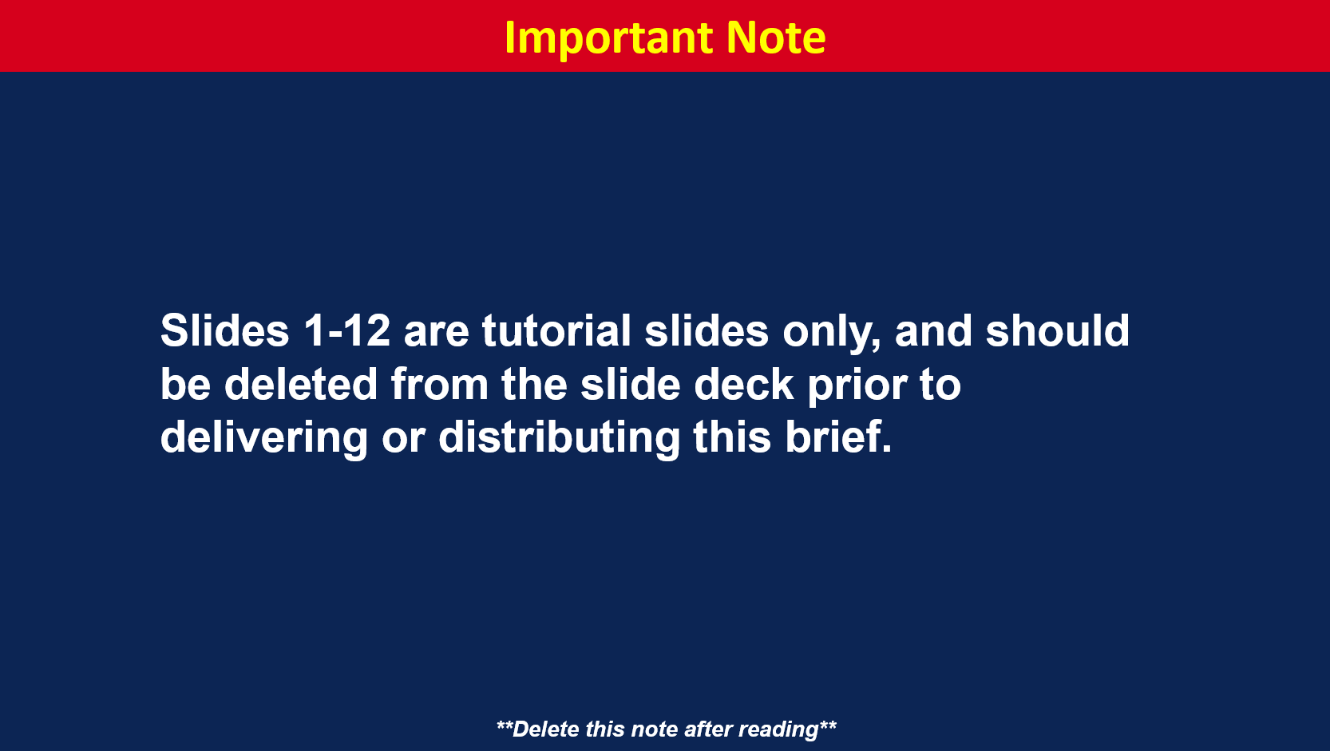
Notes:
Slides 1-12 are tutorial slides only. This slide should be deleted from the deck prior to delivering/distributing this brief.
If you have questions, feedback, or need assistance with this resource, please e-mail the OPA Defense Command Climate Portal User Support Team at DODHRA.OPA-CCA-Support@mail.mil.
**For additional DEOCS support material, please visit the Defense Command Climate Portal Survey Resource Center at https://www.prevention.mil/Climate-Portal/Defense-Climate-Portal-Survey-Resource-Center/**

Slide 3
Notes:
Slides 1-12 are tutorial slides only. This slide should be deleted from the deck prior to delivering/distributing this brief.
If you have questions, feedback, or need assistance with this resource, please e-mail the OPA Defense Command Climate Portal User Support Team at DODHRA.OPA-CCA-Support@mail.mil.
**For additional DEOCS support material, please visit the Defense Command Climate Portal Survey Resource Center at https://www.prevention.mil/Climate-Portal/Defense-Climate-Portal-Survey-Resource-Center/**

Slide 4
Notes:
Slides 1-12 are tutorial slides only. This slide should be deleted from the deck prior to delivering/distributing this brief.
If you have questions, feedback, or need assistance with this resource, please e-mail the OPA Defense Command Climate Portal User Support Team at DODHRA.OPA-CCA-Support@mail.mil.
**For additional DEOCS support material, please visit the Defense Command Climate Portal Survey Resource Center at https://www.prevention.mil/Climate-Portal/Defense-Climate-Portal-Survey-Resource-Center/**

Slide 5
Notes:
Slides 1-12 are tutorial slides only. This slide should be deleted from the deck prior to delivering/distributing this brief.
If you have questions, feedback, or need assistance with this resource, please e-mail the OPA Defense Command Climate Portal User Support Team at DODHRA.OPA-CCA-Support@mail.mil.
**For additional DEOCS support material, please visit the Defense Command Climate Portal Survey Resource Center at https://www.prevention.mil/Climate-Portal/Defense-Climate-Portal-Survey-Resource-Center/**

Slide 6
Notes:
Slides 1-12 are tutorial slides only. This slide should be deleted from the deck prior to delivering/distributing this brief.
If you have questions, feedback, or need assistance with this resource, please e-mail the OPA Defense Command Climate Portal User Support Team at DODHRA.OPA-CCA-Support@mail.mil.
**For additional DEOCS support material, please visit the Defense Command Climate Portal Survey Resource Center at https://www.prevention.mil/Climate-Portal/Defense-Climate-Portal-Survey-Resource-Center/**

Slide 7
Notes:
Slides 1-12 are tutorial slides only. This slide should be deleted from the deck prior to delivering/distributing this brief.
The above sample shows how to redact specific factors not wanting to share with unit/organization personnel.
It is strongly recommended that the following results not be shared in any unit-/organization-wide briefs:
Leadership Support – Ratings by Paygrade of Immediate Supervisor
Toxic Leadership – Ratings by Paygrade of Immediate Supervisor
Toxic Leadership – Ratings for Senior NCO/SEL
Passive Leadership – Ratings for Senior NCO/SEL
Transformational Leadership – Ratings for Senior NCO/SEL
Any custom questions included in the survey that asked participants to evaluate unique individuals/leaders.
Actual comments from your DEOCS written comments report.
If your organization only has a small number of immediate supervisors, do not share the following results:
Leadership Support – Ratings for All Immediate Supervisors
Toxic Leadership – Ratings for all Immediate Supervisors
If you have questions, feedback, or need assistance with this resource, please e-mail the OPA Defense Command Climate Portal User Support Team at DODHRA.OPA-CCA-Support@mail.mil.
**For additional DEOCS support material, please visit the Defense Command Climate Portal Survey Resource Center at https://www.prevention.mil/Climate-Portal/Defense-Climate-Portal-Survey-Resource-Center/**

Slide 8
Notes:
Slides 1-12 are tutorial slides only. This slide should be deleted from the deck prior to delivering/distributing this brief.
If you have questions, feedback, or need assistance with this resource, please e-mail the OPA Defense Command Climate Portal User Support Team at DODHRA.OPA-CCA-Support@mail.mil.
**For additional DEOCS support material, please visit the Defense Command Climate Portal Survey Resource Center at https://www.prevention.mil/Climate-Portal/Defense-Climate-Portal-Survey-Resource-Center/**

Slide 9
Notes:
Slides 1-12 are tutorial slides only. This slide should be deleted from the deck prior to delivering/distributing this brief.
If you have questions, feedback, or need assistance with this resource, please e-mail the OPA Defense Command Climate Portal User Support Team at DODHRA.OPA-CCA-Support@mail.mil.
**For additional DEOCS support material, please visit the Defense Command Climate Portal Survey Resource Center at https://www.prevention.mil/Climate-Portal/Defense-Climate-Portal-Survey-Resource-Center/**

Slide 10
Notes:
Slides 1-12 are tutorial slides only. This slide should be deleted from the deck prior to delivering/distributing this brief.
If you have questions, feedback, or need assistance with this resource, please e-mail the OPA Defense Command Climate Portal User Support Team at DODHRA.OPA-CCA-Support@mail.mil.
**For additional DEOCS support material, please visit the Defense Command Climate Portal Survey Resource Center at https://www.prevention.mil/Climate-Portal/Defense-Climate-Portal-Survey-Resource-Center/**

Slide 11
Notes:
Slides 1-12 are tutorial slides only. This slide should be deleted from the deck prior to delivering/distributing this brief.
If you have questions, feedback, or need assistance with this resource, please e-mail the OPA Defense Command Climate Portal User Support Team at DODHRA.OPA-CCA-Support@mail.mil.
**For additional DEOCS support material, please visit the Defense Command Climate Portal Survey Resource Center at https://www.prevention.mil/Climate-Portal/Defense-Climate-Portal-Survey-Resource-Center/**

Slide 12
Notes:
Slides 1-12 are tutorial slides only. This slide should be deleted from the deck prior to delivering/distributing this brief.
If you have questions, feedback, or need assistance with this resource, please e-mail the OPA Defense Command Climate Portal User Support Team at DODHRA.OPA-CCA-Support@mail.mil.
**For additional DEOCS support material, please visit the Defense Command Climate Portal Survey Resource Center at https://www.prevention.mil/Climate-Portal/Defense-Climate-Portal-Survey-Resource-Center/**

Slide 13
Notes:
Suggested Discussion Points
The DEOCS is a survey conducted by the Department of War (DoW) Office of People Analytics (OPA) to provide information we can use to improve our unit/organizational command climate. The survey asked questions about your experience at our unit/organization. The combined responses to these questions provide us with important feedback about our current command climate and help to identify strengths and challenges that may impact our unit/organization.
DoW is committed to safeguarding the information of all participants. The DEOCS System has privacy policies and secure technology in place to protect all personally identifiable information.
Survey participant answers are protected and kept confidential. No one, including myself, our survey administrator, the DEOCS team or other unit/organization leaders can view who has or has not completed the survey nor are they able to access specific individuals’ survey responses.
Results for subgroups or demographic categories with fewer than five participants are not reported.
Open-ended question responses are provided as part of our DEOCS report. These results are not linked to specific individuals and survey participants are urged repeatedly, while taking the survey, to make sure they do not unintentionally identify themselves within their written comments.

Slide 14
Notes:
Suggested Discussion Points
Introduce your CCA team members and their role on the team.
Discuss the team’s importance and how they support the CCA process.

Slide 15
Notes:
Suggested Discussion Points
Provide an overview of each step of the process.
Consideration
This process incorporates the recently published DoDI 6400.11 guidelines.
Refer to DoD Instruction 6400.11 DoD Integrated Primary Prevention Policy for Prevention Workforce and Leaders.
Refer to Service-specific guidance.

Slide 16
Notes:
Suggested Discussion Points
Thank unit/organization members for their participation.
State the overall response rate for your unit/organization, as well as by subgroup (if applicable).
Note that results are more reliable the higher the completion rate, the greater confidence we can have in our DEOCS results.
It is recommended that results for the Demographic Summary of Participants are not shared with the unit/organization as these results are sensitive.

Slide 22
Notes:
Suggested Discussion Points
Higher favorable ratings on readiness enabling factors are linked to a higher likelihood of positive outcomes, such as improved performance or readiness and higher retention and a lower likelihood of negative outcomes, such as racial/ethnic harassment and discrimination, suicide, sexual harassment, and sexual assault.
You do not need to present the results for every factor. It’s recommended that you select the factors that are most meaningful/relevant for your unit/organization as determined by your current and/or previous DEOCS results.

Slide 23
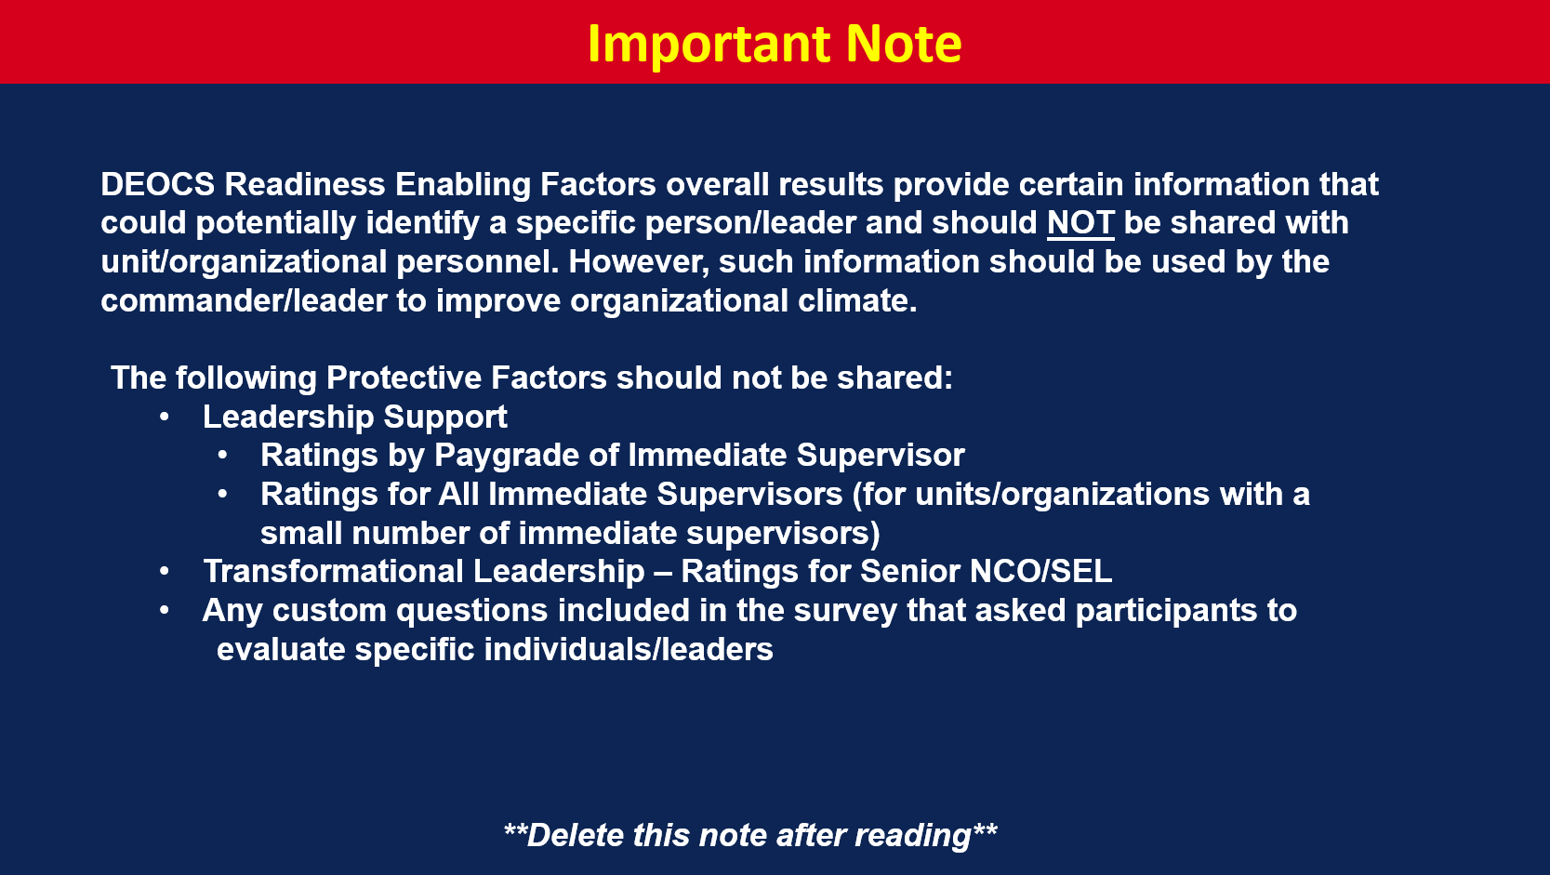
Notes:
Suggested Discussion Points
Highlight the factors with the highest and lowest favorable ratings.

Slide 24
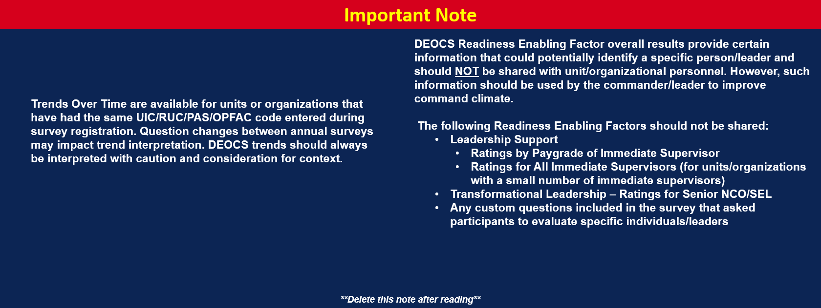
Notes:
**Delete slide if trend data is not available.**
*Trends over time are now available for any units/organizations that have completed more than one DEOCS in the past. All that is required for trends to be presented is the same UIC/RUC/PAS/OPFAC code and that the survey is administered under the same Service component as the previous survey(s).*
Suggested Discussion Points
Identify any noteworthy trends.

Slide 25
Notes:
Cohesion assesses whether individuals in a workplace care about each other, share the same mission and goals, and work together effectively.
Items used to assess Cohesion on the DEOCS using a five-point response scale from Strongly Disagree to Strongly Agree:
People in my unit work well as a team.
People in my unit trust each other.
Should We Share These Results?
Share results if the favorable rating is a top strength within the unit/organization.
Share results if a Factor Rating Alert icon is present. Factor rating alerts indicate that the unit/organization is at a high risk of experiencing negative outcomes.
Share results if the unit/organizational commander or leader believes there is another reason to share with personnel. For example, it is a previously identified area of importance or there was a notable rating increase/decrease since the last DEOCS administration, if applicable.
Suggested Discussion Points
Do these findings reflect known strengths/areas for improvement within the unit/organization?
Any surprises?
Are there any initiatives already in place (or planned) to address areas for improvement?
Are there any initiatives already in place that may be contributing to top strength areas?
Favorable rating (represented with green) indicates the extent to which the unit/organization is Cohesive.
Neutral rating (represented with yellow) indicates the extent to which the unit/organization is Neither Cohesive nor Non-Cohesive.
Unfavorable rating (represented with red) indicates the extent to which the unit/organization is Non-Cohesive.

Slide 26
Notes:
Should we share results for Cohesion Ratings by Demographic Category?
Share ratings by demographic category if overall unit/organization results were shared and/or the commander/leader sees value in sharing these results.
Do NOT share results for demographic groups with fewer than 20 individuals (see instructions for redacting demographic groups on slide 3).
Considerations
Recommend sharing demographic results. Do not draw explicit comparisons between demographic groups.

Slide 27
Notes:
Connectedness measures an individual’s closeness or belongingness to their unit or organization, and their satisfaction with their relationship to, and support from, others in that unit or organization. This also includes organizational identification which is the degree to which an individual views themselves as a member of the organization and to what extent they experience a sense of oneness with the organization’s values, brand, and methods.
Items used to assess Connectedness on the DEOCS using a five-point response scale from Strongly Disagree to Strongly Agree:
I feel like I belong.
I feel that there are people I can turn to in times of need.
I think I make things worse for the people in my life.
My future seems dark to me.
Should We Share These Results?
Share results if the favorable rating is a top strength within the unit/organization.
Share results if a Factor Rating Alert icon is present. Factor rating alerts indicate that the unit/organization is at a high risk of experiencing negative outcomes.
Share results if the unit/organizational commander or leader believes there is another reason to share with personnel. For example, the factor is a previously identified area of importance or there was a notable rating increase/decrease since the last DEOCS administration, if applicable.
Suggested Discussion Points
Do these findings reflect known strengths/areas for improvement within the unit/organization?
Any surprises?
Are there any initiatives already in place (or planned) to address areas for improvement?
Are there any initiatives already in place that may be contributing to top strength areas?
Favorable rating (represented with green) indicates the extent of High Connectedness.
Neutral rating (represented with yellow) indicates the extent of Neither High nor Low Connectedness.
Unfavorable rating (represented with red) indicates the extent of Low Connectedness.

Slide 28
Notes:
Should we share results for Connectedness Ratings by Demographic Category?
Share ratings by demographic category if overall unit/organization results were shared and/or the commander/leader sees value in sharing these results.
Do NOT share results for demographic groups with fewer than 20 individuals (see instructions for redacting demographic groups on slide 3).
Considerations
Recommend sharing demographic results. Do not draw explicit comparisons between demographic groups.

Slide 29
Notes:
Engagement & Commitment measures the extent to which one finds their work fulfilling and is committed to their job and organization. Engaged and committed individuals demonstrate enthusiasm for, and dedication to, the work that they do.
Items used to assess Engagement & Commitment on the DEOCS using a five-point response scale from Strongly Disagree to Strongly Agree:
I am proud of my work.
My work has a great deal of personal meaning to me.
I am committed to making the military my career.
Should We Share These Results?
Share results if the favorable rating is a top strength within the unit/organization.
Share results if a Factor Rating Alert icon is present. Factor rating alerts indicate that the unit/organization is at a high risk of experiencing negative outcomes.
Share results if the unit/organizational commander or leader believes there is another reason to share with personnel. For example, the factor is a previously identified area of importance or there was a notable rating increase/decrease since the last DEOCS administration, if applicable.
Suggested Discussion Points
Do these findings reflect known strengths/areas for improvement within the unit/organization?
Any surprises?
Are there any initiatives already in place (or planned) to address areas for improvement?
Are there any initiatives already in place that may be contributing to top strength areas?
Favorable rating (represented with green) indicates the extent to which there is Engagement & Commitment to the unit/organization.
Neutral rating (represented with yellow) indicates the extent to which there is Neither Engagement & Commitment nor a Lack of Engagement & Commitment to the unit/organization.
Unfavorable rating (represented with red) indicates the extent to which there is Lack of Engagement & Commitment to the unit/organization.

Slide 30
Notes:
Should we share results for Engagement & Commitment by Demographic Category?
Share ratings by demographic category if overall unit/organization results were shared and/or the commander/leader sees value in sharing these results.
Do NOT share results for demographic groups with fewer than 20 individuals (see instructions for redacting demographic groups on slide 3).
Considerations
Recommend sharing demographic results. Do not draw explicit comparisons between demographic groups.

Slide 31
Notes:
Fairness is the perception that formal and informal organizational policies, practices, and procedures regarding information sharing, job opportunities, and promotions are based on merit.
Items used to assess Fairness on the DEOCS using a five-point response scale from Strongly Disagree to Strongly Agree:
Training opportunities, awards, recognition, and other positive outcomes are distributed fairly.
Discipline and criticism are administered fairly.
Should We Share These Results?
Share results if the favorable rating is a top strength within the unit/organization.
Share results if a Factor Rating Alert icon is present. Factor rating alerts indicate that the unit/organization is at a high risk of experiencing negative outcomes.
Share results if the unit/organizational commander or leader believes there is another reason to share with personnel. For example, it is a previously identified area of importance or there was a notable rating increase/decrease since the last DEOCS administration, if applicable.
Suggested Discussion Points
Do these findings reflect known strengths/areas for improvement within the unit/organization?
Any surprises?
Are there any initiatives already in place (or planned) to address areas for improvement?
Are there any initiatives already in place that may be contributing to top strength areas?
Favorable rating (represented with green) indicates the extent to which there is Fair Treatment in the unit/organization.
Neutral rating (represented with yellow) indicates the extent to which there is Neither Fair nor Unfair Treatment in the unit/organization.
Unfavorable rating (represented with red) indicates the extent to which there is Unfair Treatment in the unit/organization.

Slide 32
Notes:
Should we share results for Fairness Ratings by Demographic Category?
Share ratings by demographic category if overall unit/organization results were shared and/or the commander/leader sees value in sharing these results.
Do NOT share results for demographic groups with fewer than 20 individuals (see instructions for redacting demographic groups on slide 3).
Considerations
Recommend sharing demographic results. Do not draw explicit comparisons between demographic groups.

Slide 33
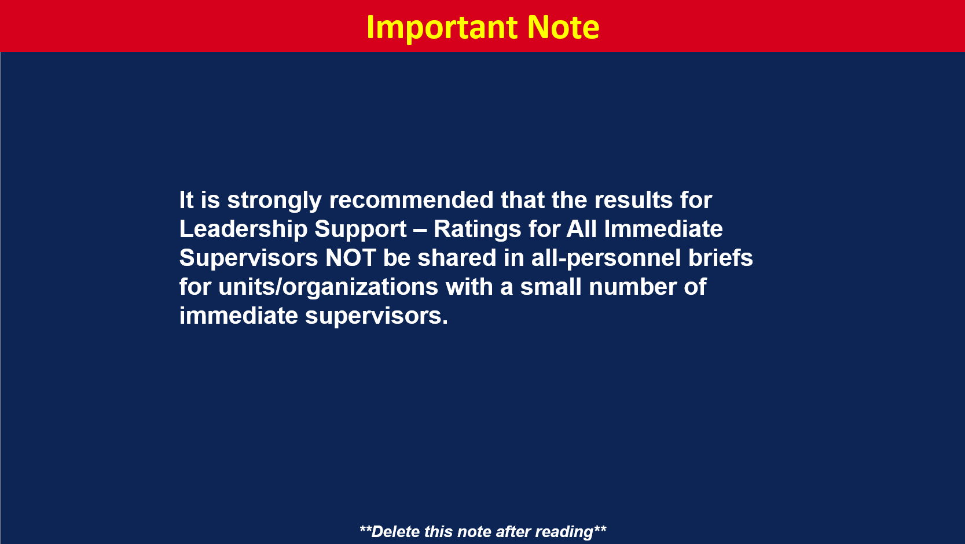
Notes:
Leadership Support is the perception that leaders build trust, encourage goal attainment and professional development, promote effective communication, and support teamwork.
Items used to assess Leadership Support on the DEOCS using a five-point response scale from Strongly Disagree to Strongly Agree:
I have trust and confidence in my immediate supervisor.
My immediate supervisor listens to what I have to say.
My immediate supervisor treats me with respect.
My immediate supervisor cares about my personal well-being.
My immediate supervisor provides me with opportunities to demonstrate my leadership skills.
I would not experience reprisal or retaliation from my immediate supervisor if I went to them with concerns.
Should We Share These Results?
Share results if the favorable rating is a top strength within the unit/organization.
Share results if a Factor Rating Alert icon is present. Factor rating alerts indicate that the unit/organization is at a high risk of experiencing negative outcomes.
Share results if the unit/organizational commander or leader believes there is another reason to share with personnel. For example, it is a previously identified area of importance or there was a notable rating increase/decrease since the last DEOCS administration, if applicable.
Suggested Discussion Points
Do these findings reflect known strengths/areas for improvement within the unit/organization?
Any surprises?
Are there any initiatives already in place (or planned) to address areas for improvement?
Are there any initiatives already in place that may be contributing to top strength areas?
Favorable rating (represented with green) percentage of responses indicating the immediate supervisor is a Supportive Leader.
Neutral rating (represented with yellow) percentage of responses indicating the immediate supervisor is Neither a Supportive nor Non-Supportive Leader.
Unfavorable ratings (represented with red) percentage of responses indicating the immediate supervisor is Not a Supportive Leader.

Slide 34
Notes:
Should we share results for Leadership Support Ratings for All Immediate Supervisors by Demographic Category?
Share ratings by demographic category if overall unit/organization results were shared and/or the commander/leader sees value in sharing these results.
Do NOT share results for demographic groups with fewer than 20 individuals (see instructions for redacting demographic groups on slide 3).
Considerations
Recommend sharing demographic results. Do not draw explicit comparisons between demographic groups.

Slide 35
Notes:
Morale is the confidence, enthusiasm, collective pride, and willingness to persist in the activities of the group. It is also an individual’s perception that members of their unit or organization are confident, enthusiastic, have collective pride, and are willing to persist in the activities of the unit or organization.
Items used to assess Morale on the DEOCS using a five-point response scale from Very Low to Very High:
Overall, how would you rate the current level of morale among the people you work with in your unit?
Overall, how would you rate your own current level of morale?
Should We Share These Results?
Share results if the favorable rating is a top strength within the unit/organization.
Share results if a Factor Rating Alert icon is present. Factor rating alerts indicate that the unit/organization is at a high risk of experiencing negative outcomes.
Share results if the unit/organizational commander or leader believes there is another reason to share with personnel. For example, it is a previously identified area of importance or there was a notable rating increase/decrease since the last DEOCS administration, if applicable.
Suggested Discussion Points
Do these findings reflect known strengths/areas for improvement within the unit/organization?
Any surprises?
Are there any initiatives already in place (or planned) to address areas for improvement?
Are there any initiatives already in place that may be contributing to top strength areas?
Favorable rating (represented with green) indicates the extent of High Morale in the unit/organization.
Neutral rating (represented with yellow) indicates the extent of Neither High nor Low Morale in the unit/organization.
Unfavorable rating (represented with red) indicates the extent of Low Morale in the unit/organization.

Slide 36
Notes:
Should we share results for Morale Rating by Demographic Category?
Share ratings by demographic category if overall unit/organization results were shared and/or the commander/leader sees value in sharing these results.
Do NOT share results for demographic groups with fewer than 20 individuals (see instructions for redacting demographic groups on slide 3).
Considerations
Recommend sharing demographic results. Do not draw explicit comparisons between demographic groups.

Slide 37
Notes:
Perceived Readiness measures unit members’ perceptions of both their own and their unit’s preparedness to perform wartime/organizational duties. Readiness perceptions are associated with objective metrics and are important for human capital preservation and enhanced readiness of the force.
Items used to assess Perceived Readiness on the DEOCS using a five-point response scale from Very Poorly Prepared to Very Well Prepared:
Overall, how well prepared are you to perform your wartime job?
Overall, how well prepared is your unit to perform its wartime mission?
Should We Share These Results?
Share results if the favorable rating is a top strength within the unit/organization.
Share results if a Factor Rating Alert icon is present. Factor rating alerts indicate that the unit/organization is at a high risk of experiencing negative outcomes.
Share results if the unit/organizational commander or leader believes there is another reason to share with personnel. For example, it is a previously identified area of importance or there was a notable rating increase/decrease since the last DEOCS administration, if applicable.
Suggested Discussion Points
Do these findings reflect known strengths/areas for improvement within the unit/organization?
Any surprises?
Are there any initiatives already in place (or planned) to address areas for improvement?
Are there any initiatives already in place that may be contributing to top strength areas?
Favorable rating (represented with green) indicates the extent of High Perceived Readiness in the unit/organization.
Neutral rating (represented with yellow) indicates the extent of Neither High nor Low Perceived Readiness in the unit/organization.
Unfavorable rating (represented with red) indicates the extent of Low Perceived Readiness in the unit/organization.

Slide 38
Notes:
Should we share results for Perceived Readiness Rating by Demographic Category?
Share ratings by demographic category if overall unit/organization results were shared and/or the commander/leader sees value in sharing these results.
Do NOT share results for demographic groups with fewer than 20 individuals (see instructions for redacting demographic groups on slide 3).
Considerations
Recommend sharing demographic results. Do not draw explicit comparisons between demographic groups.

Slide 39
Notes:
Safe Storage for Lethal Means measures whether one would keep a firearm safely stored (i.e., unloaded or in a secure storage container/device) if they had one in their living space.
Items used to assess Safe Storage for Lethal Means on the DEOCS using a five-point response scale from Strongly Disagree to Strongly Agree:
If I had a firearm in my living space, I would store it unloaded or use a secure storage container/device.
Should We Share These Results?
Share results if the favorable rating is a top strength within the unit/organization.
Share results if a Factor Rating Alert icon is present. Factor rating alerts indicate that the unit/organization is at a high risk of experiencing negative outcomes.
Share results if the unit/organizational commander or leader believes there is another reason to share with personnel. For example, it is a previously identified area of importance or there was a notable rating increase/decrease since the last DEOCS administration, if applicable.
Suggested Discussion Points
Do these findings reflect known strengths/areas for improvement within the unit/organization?
Any surprises?
Are there any initiatives already in place (or planned) to address areas for improvement?
Are there any initiatives already in place that may be contributing to top strength areas?
Favorable rating (represented with green) is the percentage of participants reporting their Firearms Would be Safely Stored.
Neutral rating (represented with yellow) is the percentage of participants reporting their Firearms May or May Not be Safely Stored.
Unfavorable rating (represented with red) is the percentage of participants reporting their Firearms Would Not be Safely Stored.

Slide 40
Notes:
Should we share results for Safe Storage for Lethal Means Ratings by Demographic Category?
Share ratings by demographic category if overall unit/organization results were shared and/or the commander/leader sees value in sharing these results.
Do NOT share results for demographic groups with fewer than 20 individuals (see instructions for redacting demographic groups on slide 3).
Considerations
Recommend sharing demographic results. Do not draw explicit comparisons between demographic groups.

Slide 41
Notes:
Transformational Leadership measures the perception that leaders encourage, inspire, and motivate others to meet new challenges and accomplish tasks beyond what they feel is possible. Characteristics of a transformational leader include idealized influence or charisma, inspirational motivation, intellectual stimulation, and individualized consideration.
Items used to assess Transformational Leadership on the DEOCS using a five-point response scale from Strongly Disagree to Strongly Agree:
My unit’s commander communicates a clear and motivating vision of the future.
My unit’s commander supports and encourages the professional development of people in my unit.
My unit’s commander encourages people in my unit to think about problems in new ways.
Should we share these results?
Share results if the favorable rating is a top strength within the unit/organization.
Share results if a Factor Rating Alert icon is present. Factor rating alerts indicate that the unit/organization is at a high risk of experiencing negative outcomes.
Share results if the unit/organizational commander or leader believes there is another reason to share with personnel. For example, it is a previously identified area of importance or there was a notable rating increase/decrease since the last DEOCS administration, if applicable.
Suggested Discussion Points
Do these findings reflect known strengths/areas for improvement within the unit/organization?
Any surprises?
Are there any initiatives already in place (or planned) to address areas for improvement?
Are there any initiatives already in place that may be contributing to top strength areas?
Favorable rating (represented with green) indicates the extent to which the unit’s/organization’s leader is a Transformational Leader.
Neutral rating (represented with yellow) indicates the extent to which the unit’s/organization’s leader is Neither a Transformational nor Non-Transformational Leader.
Unfavorable rating (represented with red) indicates the extent to which the unit’s/organization’s leader is Not a Transformational Leader.

Slide 42
Notes:
Should we share results for Transformational Leadership Ratings Unit/Organization Leader by Demographic Category?
Share ratings by demographic category if overall unit/organization results were shared and/or the commander/leader sees value in sharing these results.
Do NOT share results for demographic groups with fewer than 20 individuals (see instructions for redacting demographic groups on slide 3).
Considerations
Recommend sharing demographic results. Do not draw explicit comparisons between demographic groups.

Slide 43
Notes:
Work-Life Balance measures one’s perception that the demands of their work and personal life are compatible.
The item used to assess Work-Life Balance on the DEOCS using a five-point response scale from Strongly Disagree to Strongly Agree:
I can easily balance the demands of my work and personal life.
Recommended Talking Points
Share results if the favorable rating is a top strength within the unit/organization.
Share results if a Factor Rating Alert icon is present. Factor rating alerts indicate that the unit/organization is at a high risk of experiencing negative outcomes.
Share results if the unit/organizational commander or leader believes there is another reason to share with personnel. For example, it is a previously identified area of importance or there was a notable rating increase/decrease since the last DEOCS administration, if applicable.
Suggested Discussion Points
Do these findings reflect known strengths/areas for improvement within the unit/organization?
Any surprises?
Are there any initiatives already in place (or planned) to address areas for improvement?
Are there any initiatives already in place that may be contributing to top strength areas?
Favorable rating (represented with green) is the percentage of participants who reported Having a Work-Life Balance.
Neutral rating (represented with yellow) is the percentage of participants who reported Neither Having nor Not Having a Work-Life Balance.
Unfavorable rating (represented with red) is the percentage of participants who reported Not Having a Work-Life Balance.

Slide 44
Notes:
Should we share results for Work-Life Balance Ratings by Demographic Category?
Share ratings by demographic category if overall unit/organization results were shared and/or the commander/leader sees value in sharing these results.
Do NOT share results for demographic groups with fewer than 20 individuals (see instructions for redacting demographic groups on slide 3).
Considerations
Recommend sharing demographic results. Do not draw explicit comparisons between demographic groups.

Slide 45
Notes:
Suggested Discussion Points
Higher unfavorable ratings on readiness threatening factors are linked to a higher likelihood of negative outcomes, such as racial/ethnic harassment and discrimination, suicide, sexual harassment, and sexual assault and to a lower likelihood of positive outcomes, such as improved readiness and higher retention.
You do not need to present the results for every factor. It’s recommended that you select the factors that are most meaningful/relevant for your unit/organization as determined by your current and/or previous DEOCS results.

Slide 46
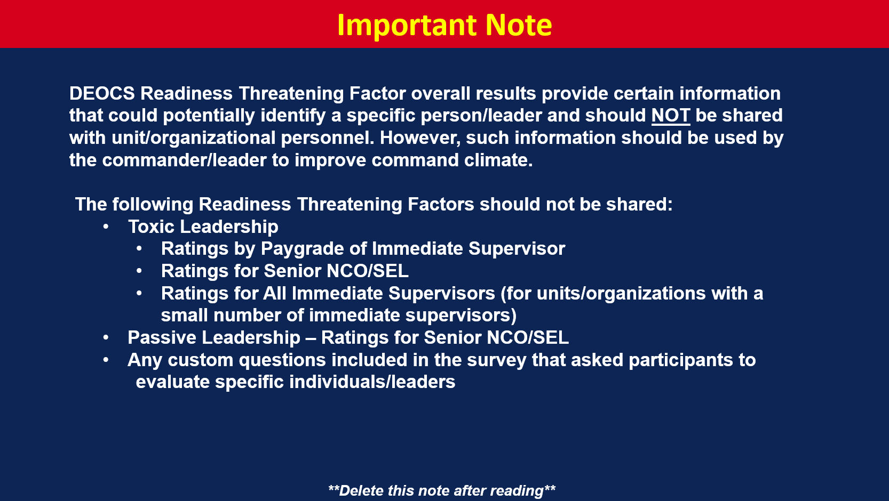
Notes:
Suggested Discussion Points
Highlight the factors with the highest and lowest unfavorable ratings.

Slide 47
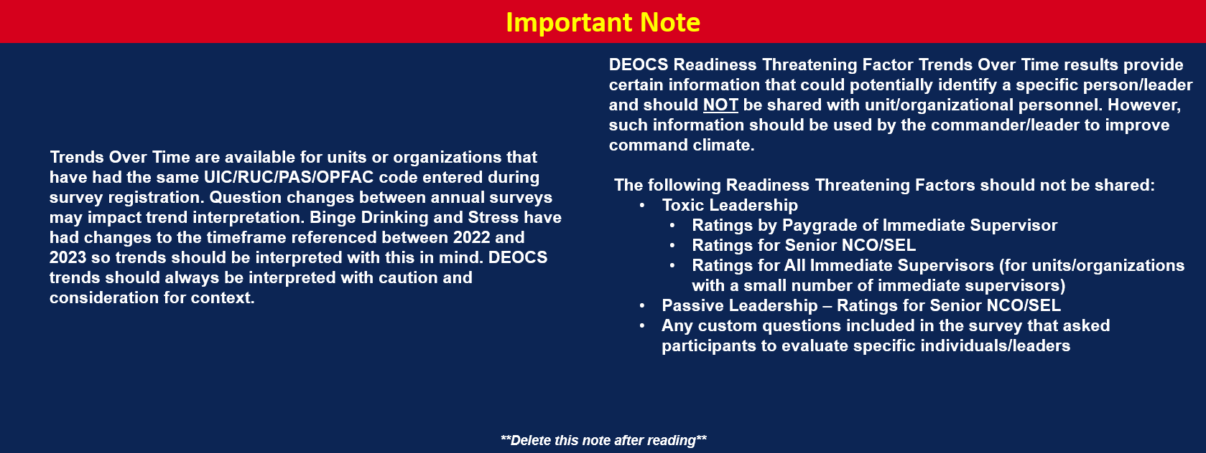
Notes:
**Delete slide if trend data is not available.**
*Trends over time are now available for any units/organizations that have completed more than one DEOCS in the past. All that is required for trends to be presented is the same UIC/RUC/PAS/OPFAC code and that the survey is administered under the same Service component as the previous survey(s).*
Suggested Discussion Points
Identify any noteworthy trends.

Slide 48
Notes:
Binge Drinking measures how often, during the last three months, one consumes 5 or more drinks on one occasion. This pattern of drinking alcohol within 2 hours brings blood alcohol concentration (BAC) to 0.08 percent or higher for typical adults.
The item used to assess Binge Drinking on the DEOCS using a five-point response scale from Never to Daily or Almost Daily:
Thinking about your alcohol use in the last three months, how often have you had five or more drinks on one occasion?
Should We Share These Results?
Share results if unfavorable rating is among the top weaknesses within the unit/organization.
Share results if a Factor Rating Alert icon is present. Factor rating alerts indicate that the unit/organization is at a high risk of experiencing negative outcomes.
Share results if the unit/organizational commander or leader believes there is another reason to share with personnel. For example, it is a previously identified area of importance or there was a notable rating increase/decrease since the last DEOCS administration, if applicable.
Suggested Discussion Points
Do these findings reflect known strengths/areas for improvement within the unit/organization?
Any surprises?
Are there any initiatives already in place (or planned) to address areas for improvement?
Are there any initiatives already in place that may be contributing to top strength areas?
Unfavorable rating (represented with red) indicates the percentage of participants reporting Frequent Binge Drinking.
Middle rating (represented with yellow) indicates the percentage of participants reporting Infrequent Binge Drinking.
Favorable rating (represented with green) indicates the percentage of participants reporting No Binge Drinking.

Slide 49
Notes:
Should we share results for Binge Drinking Ratings by Demographic Category?
Share ratings by demographic category if overall unit/organization results were shared and/or the commander/leader sees value in sharing these results.
Do NOT share results for demographic groups with fewer than 20 individuals (see instructions for redacting demographic groups on slide 3).
Considerations
Recommend sharing demographic results. Do not draw explicit comparisons between demographic groups.

Slide 50
Notes:
Passive Leadership measures the perception that leaders avoid decisions, do not respond to problems, fail to follow up, hesitate to act, and are absent when needed. This is also known as laissez-faire leadership.
The item used to assess Passive Leadership – Ratings for Unit/Organization Leader on the DEOCS using a five-point response scale from Strongly Disagree to Strongly Agree:
My unit’s commander will not take action until negative behaviors become bigger problems.
My unit’s commander does not address problems brought to their attention.
Should We Share These Results?
Share results if unfavorable rating is among the top weaknesses within the unit/organization.
Share results if a Factor Rating Alert icon is present. Factor rating alerts indicate that the unit/organization is at a high risk of experiencing negative outcomes.
Share results if the unit/organizational commander or leader believes there is another reason to share with personnel. For example, it is a previously identified area of importance or there was a notable rating increase/decrease since the last DEOCS administration, if applicable.
Suggested Discussion Points
Do these findings reflect known strengths/areas for improvement within the unit/organization?
Any surprises?
Are there any initiatives already in place (or planned) to address areas for improvement?
Are there any initiatives already in place that may be contributing to top strength areas?
Unfavorable rating (represented with red) indicates the extent to which the unit’s/organization’s leader is a Passive Leader.
Neutral rating (represented with yellow) indicates the extent to which the unit’s/organization’s leader is Neither a Passive Leader nor Non-Passive Leader.
Favorable rating (represented with green) indicates the extent to which the unit’s/organization’s leader is not a Passive Leader.

Slide 51
Notes:
Should we share results for Passive Leadership Ratings for Unit/Organization Leader by Demographic Category?
Share ratings by demographic category if overall unit/organization results were shared and/or the commander/leader sees value in sharing these results.
Do NOT share results for demographic groups with fewer than 20 individuals (see instructions for redacting demographic groups on slide 3).
Considerations
Recommend sharing demographic results. Do not draw explicit comparisons between demographic groups.

Slide 52
Notes:
Racially Harassing Behaviors measures the experience or witnessing of offensive behaviors based on their race or ethnicity that occurred over the past three months. These behaviors create a workplace that is intimidating, hostile, offensive, or unreasonably intrusive.
The items used to assess Racially Harassing Behaviors on the DEOCS using a four-point response scale from Never to Often:
How often does someone from your unit make you uncomfortable, angry, or upset by…
telling racial/ethnic jokes?
expressing stereotypes about your racial/ethnic groups?
using offensive racial/ethnic terms?
excluding you because of your race/ethnicity?
showing you a lack of respect because of your race/ethnicity?
Should We Share These Results?
Share results if unfavorable rating is among the top weaknesses within the unit/organization.
Share results if a Factor Rating Alert icon is present. Factor rating alerts indicate that the unit/organization is at a high risk of experiencing negative outcomes.
Share results if the unit/organizational commander or leader believes there is another reason to share with personnel. For example, it is a previously identified area of importance or there was a notable rating increase/decrease since the last DEOCS administration, if applicable.
Suggested Discussion Points
Do these findings reflect known strengths/areas for improvement within the unit/organization?
Any surprises?
Are there any initiatives already in place (or planned) to address areas for improvement?
Are there any initiatives already in place that may be contributing to top strength areas?
Unfavorable rating (represented with red) indicates the percentage of participants reporting a Presence of Racially Harassing Behaviors. In other words, this is the percentage of participants who reported experiencing at least one racially harassing behavior rarely, sometimes, or often in the past three months, which indicates these behaviors are present in the unit/organization.
Favorable rating (represented with green) indicates the percentage of participants reporting No Presence of Racially Harassing Behaviors. In other words, this is the percentage of participants who reported never experiencing any of the racially harassing behaviors in the past three months.

Slide 53
Notes:
Should we share results for Racially Harassing Behaviors Ratings by Demographic Category?
Share ratings by demographic category if overall unit/organization results were shared and/or the commander/leader sees value in sharing these results.
Do NOT share results for demographic groups with fewer than 20 individuals (see instructions for redacting demographic groups on slide 3).
Considerations
Recommend sharing demographic results. Do not draw explicit comparisons between demographic groups.

Slide 54
Notes:
Separation Plans measures the retention intentions of unit/organizational personnel to remain on or leave military/federal service. These intentions are associated with actual personnel turnover, which can directly impact unit readiness over time.
The item used to assess Separation Plans on the DEOCS using a four-point response scale from Very Unlikely to Very Likely:
Suppose that you have to decide whether to [stay on active duty | continue your federal service at your organization]. Assuming you could stay, how likely is it that you would choose to do so?
Should We Share These Results?
Share results if unfavorable rating is among the top weaknesses within the unit/organization.
Share results if a Factor Rating Alert icon is present. Factor rating alerts indicate that the unit/organization is at a high risk of experiencing negative outcomes.
Share results if the unit/organizational commander or leader believes there is another reason to share with personnel. For example, it is a previously identified area of importance or there was a notable rating increase/decrease since the last DEOCS administration, if applicable.
Suggested Discussion Points
Do these findings reflect known strengths/areas for improvement within the unit/organization?
Any surprises?
Are there any initiatives already in place (or planned) to address areas for improvement?
Are there any initiatives already in place that may be contributing to top strength areas?
Unfavorable rating (represented with red) percentage of responses indicate the extent of Moderate or High Separation Plans within the unit/organization.
Favorable rating (represented with green) percentage of responses indicate the extent of Low Separation Plans within the unit/organization.

Slide 55
Notes:
Should we share results for Separation Plans Ratings by Demographic Category?
Share ratings by demographic category if overall unit/organization results were shared and/or the commander/leader sees value in sharing these results.
Do NOT share results for demographic groups with fewer than 20 individuals (see instructions for redacting demographic groups on slide 3).
Considerations
Recommend sharing demographic results. Do not draw explicit comparisons between demographic groups.

Slide 56
Notes:
Sexually Harassing Behaviors measures unwelcome sexual advances, requests for sexual favors, and offensive comments or gestures of a sexual nature that occurred over the past three months.
The item used to assess Sexually Harassing Behaviors on the DEOCS using a four-point response scale from Never to Often:
How often does someone from your unit…
tell sexual jokes that make you uncomfortable, angry, or upset?
embarrass, anger, or upset you by suggesting that you do not act how a man or a woman is supposed to act?
display, show, or send sexually explicit materials (such as pictures or videos) that make you uncomfortable, angry, or upset?
make sexual comments about your appearance or body that make you uncomfortable, angry, or upset?
intentionally touch you in unwanted sexual ways?
Should We Share These Results?
Share results if unfavorable rating is among the top weaknesses within the unit/organization.
Share results if a Factor Rating Alert icon is present. Factor rating alerts indicate that the unit/organization is at a high risk of experiencing negative outcomes.
Share results if the unit/organizational commander or leader believes there is another reason to share with personnel. For example, it is a previously identified area of importance or there was a notable rating increase/decrease since the last DEOCS administration, if applicable.
Suggested Discussion Points
Do these findings reflect known strengths/areas for improvement within the unit/organization?
Any surprises?
Are there any initiatives already in place (or planned) to address areas for improvement?
Are there any initiatives already in place that may be contributing to top strength areas?
Unfavorable rating (represented with red) indicates the percentage of participants reporting a Presence of Sexually Harassing Behaviors. In other words, this is the percentage of participants who reported experiencing at least one sexually harassing behavior rarely, sometimes, or often in the past three months, which indicates these behaviors are present in the unit/organization.
Favorable rating (represented with green) indicates the percentage of participants reporting No Presence of Sexually Harassing Behaviors. In other words, this is the percentage of participants who reported never experiencing any of the sexually harassing behaviors in the past three months.

Slide 57
Notes:
Should we share results for Sexually Harassing Behaviors Ratings by Demographic Category?
Share ratings by demographic category if overall unit/organization results were shared and/or the commander/leader sees value in sharing these results.
Do NOT share results for demographic groups with fewer than 20 individuals (see instructions for redacting demographic groups on slide 3).
Considerations
Recommend sharing demographic results. Do not draw explicit comparisons between demographic groups.

Slide 58
Notes:
Stress measures the feeling of emotional strain or pressure. Stressed individuals may feel unable to predict or influence valued and prominent aspects of their lives.
The items used to assess Stress on the DEOCS using a four-point response scale from Never to Often:
In the past three months, how often have you felt nervous or stressed?
In the past three months, how often have you found that you could not cope with all of the things you had to do?
Should We Share These Results?
Share results if unfavorable rating is among the top weaknesses within the unit/organization.
Share results if a Factor Rating Alert icon is present. Factor rating alerts indicate that the unit/organization is at a high risk of experiencing negative outcomes.
Share results if the unit/organizational commander or leader believes there is another reason to share with personnel. For example, it is a previously identified area of importance or there was a notable rating increase/decrease since the last DEOCS administration, if applicable.
Suggested Discussion Points
Do these findings reflect known strengths/areas for improvement within the unit/organization?
Any surprises?
Are there any initiatives already in place (or planned) to address areas for improvement?
Are there any initiatives already in place that may be contributing to top strength areas?
Unfavorable rating (represented with red) percentage of responses indicate the extent of Moderate or High Stress within the unit/organization.
Favorable rating (represented with green) percentage of responses indicate the extent of Low Stress within the unit/organization.

Slide 59
Notes:
Should we share results for Stress Ratings by Demographic Category?
Share ratings by demographic category if overall unit/organization results were shared and/or the commander/leader sees value in sharing these results.
Do NOT share results for demographic groups with fewer than 20 individuals (see instructions for redacting demographic groups on slide 3).
Considerations
Recommend sharing demographic results. Do not draw explicit comparisons between demographic groups.

Slide 60
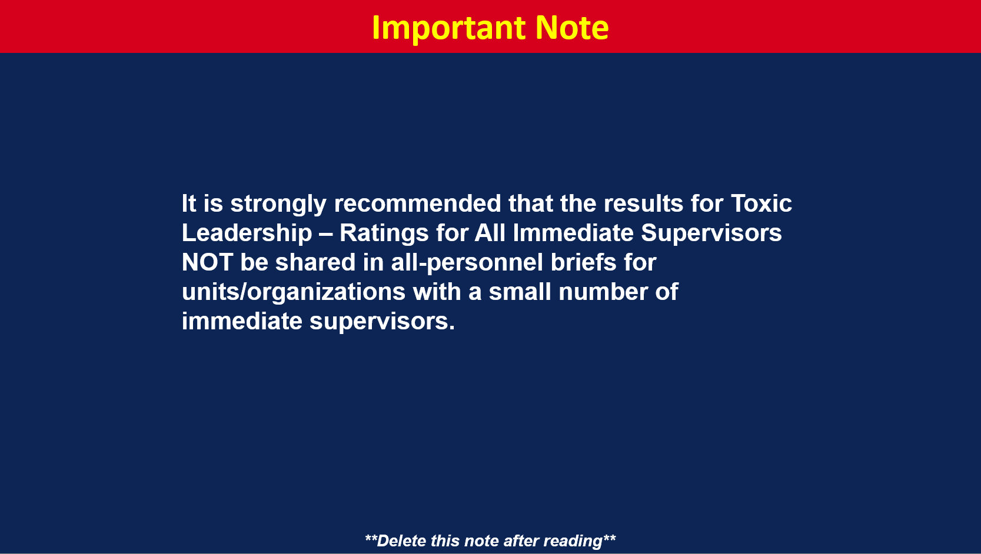
Notes:
Toxic Leadership measures the perception that leaders disregard input, ridicule others, and have self-promoting tendencies. Toxic Leadership also includes behaviors that are demeaning, isolating, and/or coercive. These types of leaders are also prone to acts of aggression.
The item used to assess Toxic Leadership – Ratings for All Immediate Supervisors on the DEOCS using a five-point response scale from Strongly Disagree to Strongly Agree:
My immediate supervisor ridicules people in my unit.
My immediate supervisor acts only in the best interest of their own advancement.
My immediate supervisor ignores input from people in my unit that they do not agree with.
Should We Share These Results?
Share results if unfavorable rating is among the top weaknesses within the unit/organization.
Share results if a Factor Rating Alert icon is present. Factor rating alerts indicate that the unit/organization is at a high risk of experiencing negative outcomes.
Share results if the unit/organizational commander or leader believes there is another reason to share with personnel. For example, it is a previously identified area of importance or there was a notable rating increase/decrease since the last DEOCS administration, if applicable.
Suggested Discussion Points
Do these findings reflect known strengths/areas for improvement within the unit/organization?
Any surprises?
Are there any initiatives already in place (or planned) to address areas for improvement?
Are there any initiatives already in place that may be contributing to top strength areas?
Unfavorable rating (represented with red) percentage of responses indicating the immediate supervisor is a Toxic Leader.
Neutral rating (represented with yellow) percentage of responses indicating the immediate supervisor is Neither a Toxic nor Non-Toxic Leader.
Favorable rating (represented with green) percentage of responses indicating the immediate supervisor is Not a Toxic Leader.

Slide 61
Notes:
Workplace Hostility measures the degree to which individuals in the workplace act in a hostile manner towards others. It includes behaviors such as insults, sarcasm, or gestures intended to humiliate a member as well as perception of others interfering with one’s work performance.
The item used to assess Workplace Hostility on the DEOCS using a four-point response scale from Never to Often:
How often does someone from your unit…
intentionally interfere with your work performance?
take credit for work or ideas that were yours?
use insults, sarcasm, or gestures to humiliate you?
yell when they are angry with you?
Should We Share These Results?
Share results if unfavorable rating is among the top weaknesses within the unit/organization.
Share results if a Factor Rating Alert icon is present. Factor rating alerts indicate that the unit/organization is at a high risk of experiencing negative outcomes.
Share results if the unit/organizational commander or leader believes there is another reason to share with personnel. For example, it is a previously identified area of importance or there was a notable rating increase/decrease since the last DEOCS administration, if applicable.
Suggested Discussion Points
Do these findings reflect known strengths/areas for improvement within the unit/organization?
Any surprises?
Are there any initiatives already in place (or planned) to address areas for improvement?
Are there any initiatives already in place that may be contributing to top strength areas?
Unfavorable rating (represented with red) percentage of responses indicating Frequent Workplace Hostility.
Neither favorable nor unfavorable rating (represented with yellow) percentage of responses indicating Rare Workplace Hostility.
Favorable rating (represented with green) percentage of responses indicating No Workplace Hostility.

Slide 62
Notes:
Should we share results for Workplace Hostility Ratings by Demographic Category?
Share ratings by demographic category if overall unit/organization results were shared and/or the commander/leader sees value in sharing these results.
Do NOT share results for demographic groups with fewer than 20 individuals (see instructions for redacting demographic groups on slide 3).
Considerations
Recommend sharing demographic results. Do not draw explicit comparisons between demographic groups.

Slide 64
Notes:
Suggested Discussion Points
Share written comment themes only. Do not share quotes from your Comments Report.
DEOCS results are confidential, however sharing quotes may inadvertently identify individuals.

Slide 66
Notes:
Suggested Discussion Points
Discuss noteworthy results.

Slide 68
Notes:
Suggested Discussion Points
Discuss noteworthy results.

Slide 69
Notes:
**For use at Military Service Academies, only. Otherwise, delete this section.**

Slide 70
Notes:
Considerations
Due to the number of Academy-specific questions, it’s anticipated that multiple slides will be required to display these results.
Suggested Discussion Points
Discuss noteworthy results.

Slide 72
Notes:
Suggested Discussion Points
Provide an overview of next steps for the unit/organization.

Slide 73
Notes:
Suggested Discussion Points
Ask attendees for their thoughts about the presentation material. Solicit questions.

Slide 74
Notes:
Suggested Discussion Points
Discuss the availability of local resources. Introduce any POCs in attendance.

Slide 75
Notes:
Suggested Discussion Points
Thank the CCA team and the briefing attendees.
Thank DEOCS participants.
Thank brief attendees for participation and discussion (if applicable).

