Slide 1
Notes:
DEOCS Brief Template – Commander’s Supervisor
No customization needed.
Slides 1-10 are tutorial slides only. This slide should be deleted from the deck prior to delivering/distributing this brief.
If you have questions, feedback, or need assistance with this resource, please e-mail the OPA Defense Command Climate Portal User Support Team at DODHRA.OPA-CCA-Support@mail.mil.
**For additional DEOCS support material, please visit the Defense Command Climate Portal Survey Resource Center at https://www.prevention.mil/Climate-Portal/Defense-Climate-Portal-Survey-Resource-Center/**

Slide 2
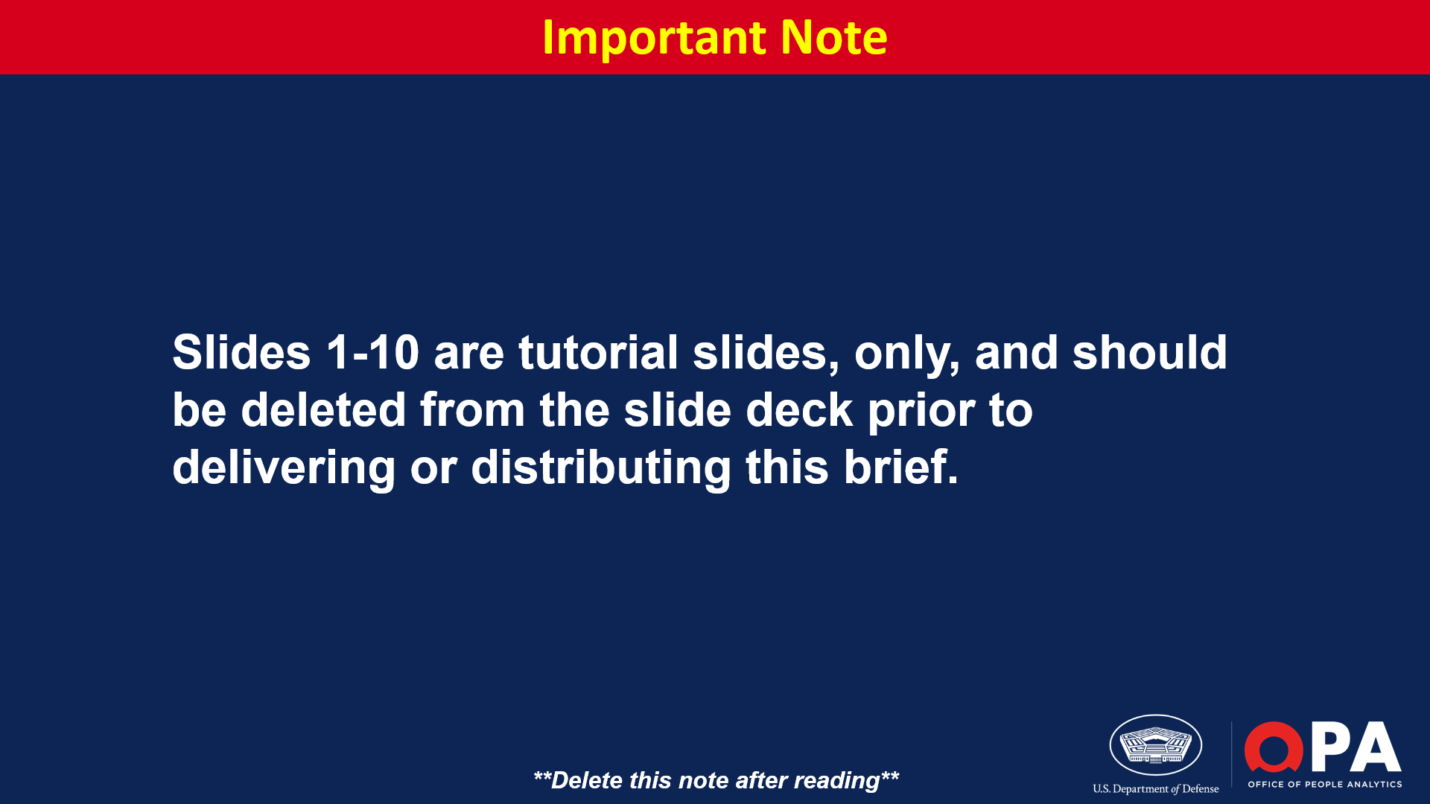
Notes:
Slides 1-10 are tutorial slides only. This slide should be deleted from the deck prior to delivering/distributing this brief.
If you have questions, feedback, or need assistance with this resource, please e-mail the OPA Defense Command Climate Portal User Support Team at DODHRA.OPA-CCA-Support@mail.mil.
**For additional DEOCS support material, please visit the Defense Command Climate Portal Survey Resource Center at https://www.prevention.mil/Climate-Portal/Defense-Climate-Portal-Survey-Resource-Center/**

Slide 3
Notes:
Slides 1-10 are tutorial slides only. This slide should be deleted from the deck prior to delivering/distributing this brief.
If you have questions, feedback, or need assistance with this resource, please e-mail the OPA Defense Command Climate Portal User Support Team at DODHRA.OPA-CCA-Support@mail.mil.
**For additional DEOCS support material, please visit the Defense Command Climate Portal Survey Resource Center at https://www.prevention.mil/Climate-Portal/Defense-Climate-Portal-Survey-Resource-Center/**

Slide 4
Notes:
Slides 1-10 are tutorial slides only. This slide should be deleted from the deck prior to delivering/distributing this brief.
If you have questions, feedback, or need assistance with this resource, please e-mail the OPA Defense Command Climate Portal User Support Team at DODHRA.OPA-CCA-Support@mail.mil.
**For additional DEOCS support material, please visit the Defense Command Climate Portal Survey Resource Center at https://www.prevention.mil/Climate-Portal/Defense-Climate-Portal-Survey-Resource-Center/**

Slide 5
Notes:
Slides 1-10 are tutorial slides only. This slide should be deleted from the deck prior to delivering/distributing this brief.
If you have questions, feedback, or need assistance with this resource, please e-mail the OPA Defense Command Climate Portal User Support Team at DODHRA.OPA-CCA-Support@mail.mil.
**For additional DEOCS support material, please visit the Defense Command Climate Portal Survey Resource Center at https://www.prevention.mil/Climate-Portal/Defense-Climate-Portal-Survey-Resource-Center/**

Slide 6
Notes:
Slides 1-10 are tutorial slides only. This slide should be deleted from the deck prior to delivering/distributing this brief.
If you have questions, feedback, or need assistance with this resource, please e-mail the OPA Defense Command Climate Portal User Support Team at DODHRA.OPA-CCA-Support@mail.mil.
**For additional DEOCS support material, please visit the Defense Command Climate Portal Survey Resource Center at https://www.prevention.mil/Climate-Portal/Defense-Climate-Portal-Survey-Resource-Center/**

Slide 7
Notes:
Slides 1-10 are tutorial slides only. This slide should be deleted from the deck prior to delivering/distributing this brief.
If you have questions, feedback, or need assistance with this resource, please e-mail the OPA Defense Command Climate Portal User Support Team at DODHRA.OPA-CCA-Support@mail.mil.
**For additional DEOCS support material, please visit the Defense Command Climate Portal Survey Resource Center at https://www.prevention.mil/Climate-Portal/Defense-Climate-Portal-Survey-Resource-Center/**

Slide 8
Notes:
Slides 1-10 are tutorial slides only. This slide should be deleted from the deck prior to delivering/distributing this brief.
If you have questions, feedback, or need assistance with this resource, please e-mail the OPA Defense Command Climate Portal User Support Team at DODHRA.OPA-CCA-Support@mail.mil.
**For additional DEOCS support material, please visit the Defense Command Climate Portal Survey Resource Center at https://www.prevention.mil/Climate-Portal/Defense-Climate-Portal-Survey-Resource-Center/**

Slide 9
Notes:
Slides 1-10 are tutorial slides only. This slide should be deleted from the deck prior to delivering/distributing this brief.
If you have questions, feedback, or need assistance with this resource, please e-mail the OPA Defense Command Climate Portal User Support Team at DODHRA.OPA-CCA-Support@mail.mil.
**For additional DEOCS support material, please visit the Defense Command Climate Portal Survey Resource Center at https://www.prevention.mil/Climate-Portal/Defense-Climate-Portal-Survey-Resource-Center/**

Slide 10
Notes:
Slides 1-10 are tutorial slides only. This slide should be deleted from the deck prior to delivering/distributing this brief.
If you have questions, feedback, or need assistance with this resource, please e-mail the OPA Defense Command Climate Portal User Support Team at DODHRA.OPA-CCA-Support@mail.mil.
**For additional DEOCS support material, please visit the Defense Command Climate Portal Survey Resource Center at https://www.prevention.mil/Climate-Portal/Defense-Climate-Portal-Survey-Resource-Center/**

Slide 12
Notes:
Suggested Discussion Points
High-level overview of the CCA team and their contributions.
Highlight subject matter experts (e.g., EOA/CCS, SAPRO, survey administrator).

Slide 13
Notes:
Suggested Discussion Points
Provide an overview of each step of the process.
Consideration
This process incorporates the recently published DoDI 6400.11 guidelines.
Refer to DoD Instruction 6400.11 DoD Integrated Primary Prevention Policy for Prevention Workforce and Leaders and/or Service-specific guidance.

Slide 14
Notes:
Suggested Discussion Points
Discuss the overall response rate and any subgroup response rates.
Discuss rationale for creating subgroups.
Compare to historical response rates, if applicable.

Slide 15
Notes:
Suggested Discussion Points
Based on members self-reported responses to the DEOCS demographic questions
Demographic results are only reported if there are five or more responses for each sub-section of a given demographic category.

Slide 21
Notes:
Suggested Discussion Points
Higher favorable ratings on protective factors are linked to a higher likelihood of positive outcomes.
You do not need to present the results for every factor.
It’s recommended that you select the factors that are most meaningful/relevant for your unit as determined by your current and/or previous DEOCS results.

Slide 22
Notes:
Suggested Discussion Points
Highlight the protective factors with the highest and lowest favorable ratings.

Slide 23
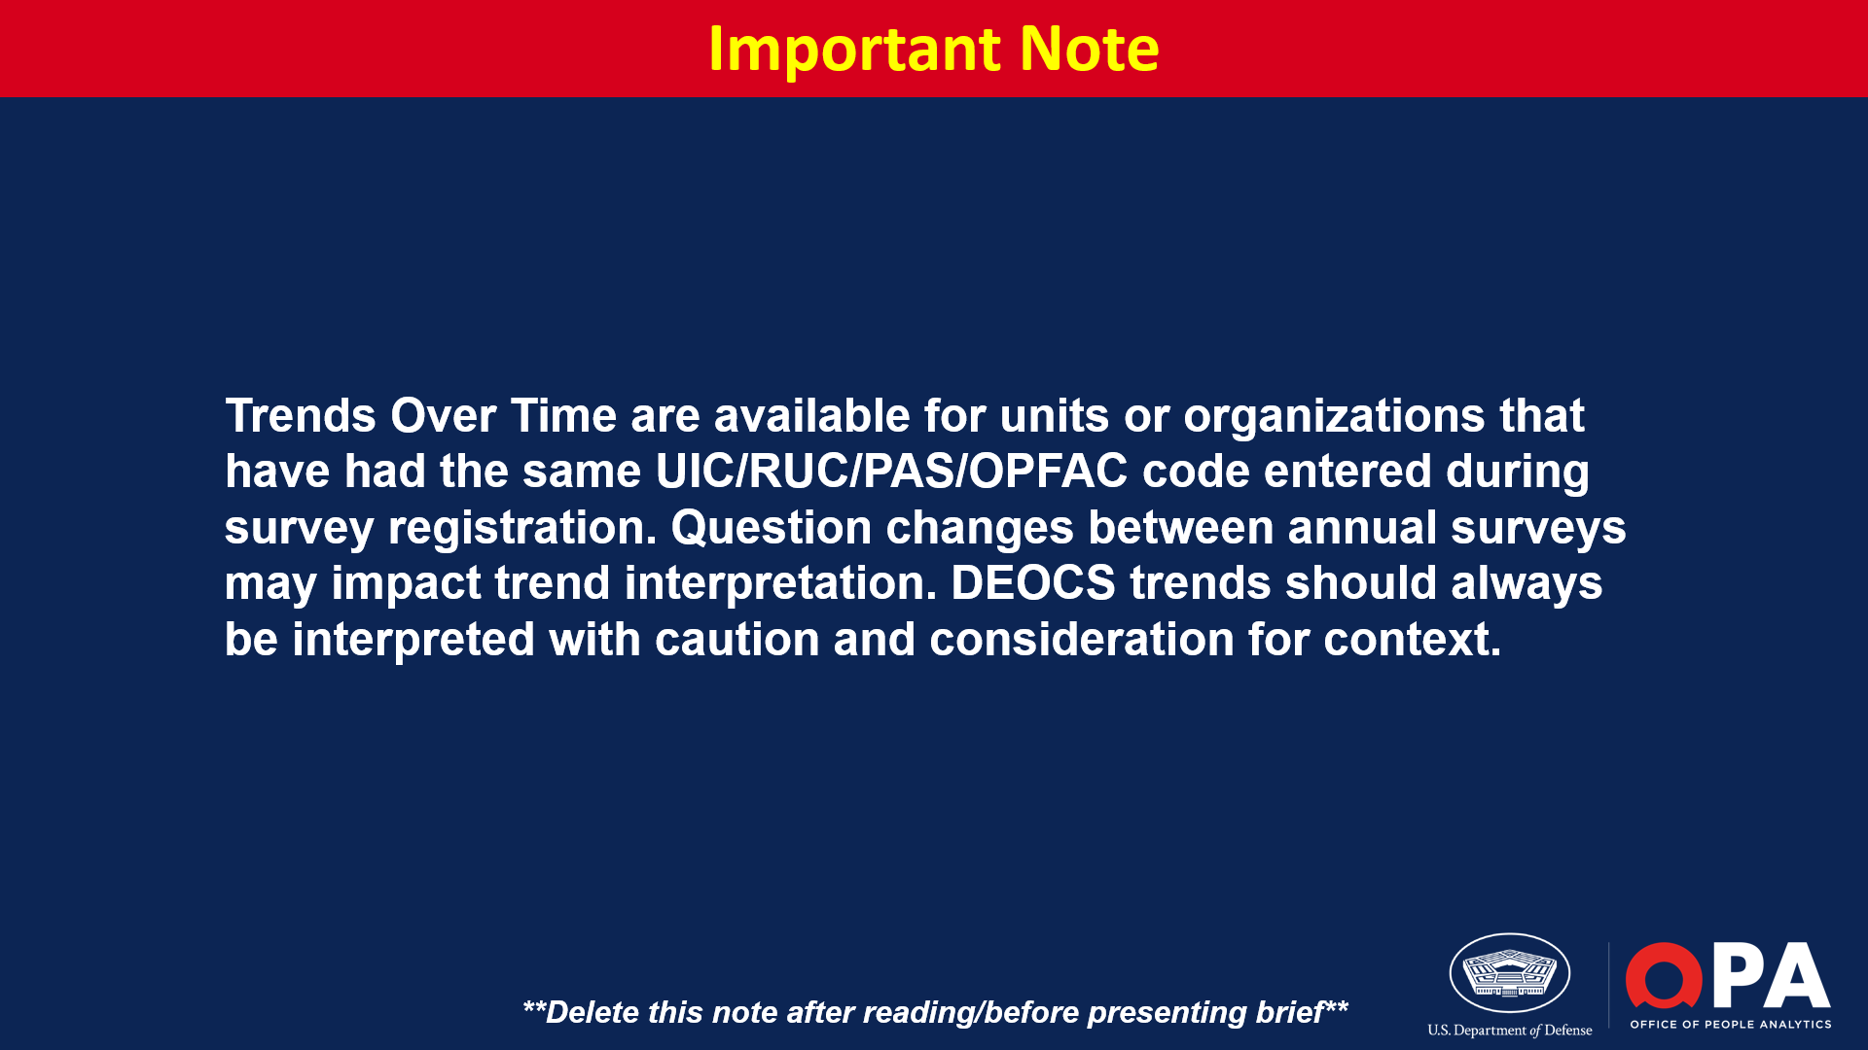
Notes:
**Delete slide if trend data is not available.**
*Trends over time are now available for any units/organizations that have completed more than one DEOCS in the past. All that is required for trends to be presented is the same UIC/RUC/PAS/OPFAC code and that the survey is administered under the same Service component as the previous survey(s).*
Suggested Discussion Points
Identify upward and/or downward trends.
Discuss notable differences in response rates when reviewing trends over time.
Identify any other noteworthy trends.

Slide 24
Notes:
Cohesion assesses whether individuals in a workplace care about each other, share the same mission and goals, and work together effectively.
Favorable rating (represented with green) indicates the extent to which the unit/organization is Cohesive.
Neutral rating (represented with yellow) indicates the extent to which the unit/organization is Neither Cohesive nor Non-Cohesive.
Unfavorable rating (represented with red) indicates the extent to which the unit/organization is Non-Cohesive.
Sharing Results with the Commander’s Supervisor
Share results if this factor is an area of growth for your unit/organization or on the Comprehensive Integrated Primary Prevention (CIPP) Plan.
Share results if a Factor Rating Alert icon is present. Factor rating alerts indicate that the unit/organization is at a high risk of experiencing negative outcomes.
Share results if the commander/leader believes there is another reason to share with their supervisor.
Suggested Discussion Points
Discuss activities pertinent to this factor for your unit/organization.
Discuss trends from previous DEOCS results, if applicable.

Slide 25
Notes:
Sharing Results with the Commander’s Supervisor
Share demographic category results if overall results were shared with the previous slide.
Share demographic category results if the commander/leader sees value in sharing these results.
Suggested Discussion Points
Discuss noteworthy differences and outliers in demographic category results.

Slide 26
Notes:
Connectedness measures an individual’s closeness or belongingness to their unit or organization, and their satisfaction with their relationship to, and support from, others in that unit or organization. This also includes organizational identification which is the degree to which an individual views themselves as a member of the organization and to what extent they experience a sense of oneness with the organization’s values, brand, and methods.
Favorable rating (represented with green) indicates the extent of High Connectedness.
Neutral rating (represented with yellow) indicates the extent of Neither High nor Low Connectedness.
Unfavorable rating (represented with red) indicates the extent of Low Connectedness.
Sharing Results with the Commander’s Supervisor
Share results if this factor is an area of growth for your unit/organization or on the Comprehensive Integrated Primary Prevention (CIPP) Plan.
Share results if a Factor Rating Alert icon is present. Factor rating alerts indicate that the unit/organization is at a high risk of experiencing negative outcomes.
Share results if the commander/leader believes there is another reason to share with their supervisor.
Suggested Discussion Points
Discuss activities pertinent to this factor for your unit/organization.
Discuss trends from previous DEOCS results, if applicable.

Slide 27
Notes:
Sharing Results with the Commander’s Supervisor
Share demographic category results if overall results were shared with the previous slide.
Share demographic category results if the commander/leader sees value in sharing these results.
Suggested Discussion Points
Discuss noteworthy differences and outliers in demographic category results.

Slide 28
Notes:
Engagement & Commitment measures the extent to which one finds their work fulfilling and is committed to their job and unit/organization. Engaged and committed individuals demonstrate enthusiasm for, and dedication to, the work that they do.
Favorable rating (represented with green) indicates the extent to which there is Engagement & Commitment to the unit/organization.
Neutral rating (represented with yellow) indicates the extent to which there is Neither Engagement & Commitment nor a Lack of Engagement & Commitment to the unit/organization.
Unfavorable rating (represented with red) indicates the extent to which there is Lack of Engagement & Commitment to the unit/organization.
Sharing Results with the Commander’s Supervisor
Share results if this factor is an area of growth for your unit/organization or on the Comprehensive Integrated Primary Prevention (CIPP) Plan.
Share results if a Factor Rating Alert icon is present. Factor rating alerts indicate that the unit/organization is at a high risk of experiencing negative outcomes.
Share results if the commander/leader believes there is another reason to share with their supervisor.
Suggested Discussion Points
Discuss activities pertinent to this factor for your unit/organization.
Discuss trends from previous DEOCS results, if applicable.

Slide 29
Notes:
Sharing Results with the Commander’s Supervisor
Share demographic category results if overall results were shared with the previous slide.
Share demographic category results if the commander/leader sees value in sharing these results.
Suggested Discussion Points
Discuss noteworthy differences and outliers in demographic category results.

Slide 30
Notes:
Fairness is the perception that formal and informal organizational policies, practices, and procedures regarding information sharing, job opportunities, and promotions are based on merit.
Favorable rating (represented with green) indicates the extent to which there is Fair Treatment in the unit/organization.
Neutral rating (represented with yellow) indicates the extent to which there is Neither Fair nor Unfair Treatment in the unit/organization.
Unfavorable rating (represented with red) indicates the extent to which there is Unfair Treatment in the unit/organization.
Sharing Results with the Commander’s Supervisor
Share results if this factor is an area of growth for your unit/organization or on the Comprehensive Integrated Primary Prevention (CIPP) Plan.
Share results if a Factor Rating Alert icon is present. Factor rating alerts indicate that the unit/organization is at a high risk of experiencing negative outcomes.
Share results if the commander/leader believes there is another reason to share with their supervisor.
Suggested Discussion Points
Discuss activities pertinent to this factor for your unit/organization.
Discuss trends from previous DEOCS results, if applicable.

Slide 31
Notes:
Sharing Results with the Commander’s Supervisor
Share demographic category results if overall results were shared with the previous slide.
Share demographic category results if the commander/leader sees value in sharing these results.
Suggested Discussion Points
Discuss noteworthy differences and outliers in demographic category results.

Slide 32
Notes:
Leadership Support is the perception that leaders build trust, encourage goal attainment and professional development, promote effective communication, and support teamwork.
Favorable rating (represented with green) percentage of responses indicating the immediate supervisor is a Supportive Leader.
Neutral rating (represented with yellow) percentage of responses indicating the immediate supervisor is Neither a Supportive nor Non-Supportive Leader.
Unfavorable ratings (represented with red) percentage of responses indicating the immediate supervisor is Not a Supportive Leader.
Sharing Results with the Commander’s Supervisor
Share results if this factor is an area of growth for your unit/organization or on the Comprehensive Integrated Primary Prevention (CIPP) Plan.
Share results if a Factor Rating Alert icon is present. Factor rating alerts indicate that the unit/organization is at a high risk of experiencing negative outcomes.
Share results if the commander/leader believes there is another reason to share with their supervisor.
Suggested Discussion Points
Discuss activities pertinent to this factor for your unit/organization.
Discuss trends from previous DEOCS results, if applicable.

Slide 33
Notes:
Sharing Results with the Commander’s Supervisor
Share demographic category results if overall results were shared with the previous slide.
Share demographic category results if the commander/leader sees value in sharing these results.
Suggested Discussion Points
Discuss noteworthy differences and outliers in demographic category results.

Slide 34
Notes:
Sharing Results with the Commander’s Supervisor
Share demographic category results if overall results were shared with the previous slide.
Share demographic category results if the commander/leader sees value in sharing these results.
Suggested Discussion Points
Discuss noteworthy differences and outliers in demographic category results.

Slide 35
Notes:
Morale is the confidence, enthusiasm, collective pride, and willingness to persist in the activities of the group. It is also an individual’s perception that members of their unit or organization are confident, enthusiastic, have collective pride, and are willing to persist in the activities of the unit or organization.
Favorable rating (represented with green) indicates the extent of High Morale in the unit/organization.
Neutral rating (represented with yellow) indicates the extent of Neither High nor Low Morale in the unit/organization.
Unfavorable rating (represented with red) indicates the extent of Low Morale in the unit/organization.
Sharing Results with the Commander’s Supervisor
Share results if this factor is an area of growth for your unit/organization or on the Comprehensive Integrated Primary Prevention (CIPP) Plan.
Share results if a Factor Rating Alert icon is present. Factor rating alerts indicate that the unit/organization is at a high risk of experiencing negative outcomes.
Share results if the commander/leader believes there is another reason to share with their supervisor.
Suggested Discussion Points
Discuss activities pertinent to this factor for your unit/organization.
Discuss trends from previous DEOCS results, if applicable.

Slide 36
Notes:
Sharing Results with the Commander’s Supervisor
Share demographic category results if overall results were shared with the previous slide.
Share demographic category results if the commander/leader sees value in sharing these results.
Suggested Discussion Points
Discuss noteworthy differences and outliers in demographic category results.

Slide 37
Notes:
Safe Storage for Lethal Means measures whether one would keep a firearm safely stored (i.e., unloaded or in a secure storage container/device) if they had one in their living space.
Favorable rating (represented with green) is the percentage of participants reporting their Firearms Would be Safely Stored.
Neutral rating (represented with yellow) is the percentage of participants reporting their Firearms May or May Not be Safely Stored.
Unfavorable rating (represented with red) is the percentage of participants reporting their Firearms Would Not be Safely Stored.
Sharing Results with the Commander’s Supervisor
Share results if this factor is an area of growth for your unit/organization or on the Comprehensive Integrated Primary Prevention (CIPP) Plan.
Share results if a Factor Rating Alert icon is present. Factor rating alerts indicate that the unit/organization is at a high risk of experiencing negative outcomes.
Share results if the commander/leader believes there is another reason to share with their supervisor.
Suggested Discussion Points
Discuss activities pertinent to this factor for your unit/organization.
Discuss trends from previous DEOCS results, if applicable.

Slide 38
Notes:
Sharing Results with the Commander’s Supervisor
Share demographic category results if overall results were shared with the previous slide.
Share demographic category results if the commander/leader sees value in sharing these results.
Suggested Discussion Points
Discuss noteworthy differences and outliers in demographic category results.

Slide 39
Notes:
Transformational Leadership measures the perception that leaders encourage, inspire, and motivate others to meet new challenges and accomplish tasks beyond what they feel is possible. Characteristics of a transformational leader include idealized influence or charisma, inspirational motivation, intellectual stimulation, and individualized consideration.
Favorable rating (represented with green) indicates the extent to which the unit’s/organization’s leader is a Transformational Leader.
Neutral rating (represented with yellow) indicates the extent to which the unit’s/organization’s leader is Neither a Transformational nor Non-Transformational Leader.
Unfavorable rating (represented with red) indicates the extent to which the unit’s/organization’s leader is Not a Transformational Leader.
Sharing Results with the Commander’s Supervisor
Share results if this factor is an area of growth for your unit/organization or on the Comprehensive Integrated Primary Prevention (CIPP) Plan.
Share results if a Factor Rating Alert icon is present. Factor rating alerts indicate that the unit/organization is at a high risk of experiencing negative outcomes.
Share results if the commander/leader believes there is another reason to share with their supervisor.
Suggested Discussion Points
Discuss activities pertinent to this factor for your unit/organization.
Discuss trends from previous DEOCS results, if applicable.

Slide 40
Notes:
Sharing Results with the Commander’s Supervisor
Share demographic category results if overall results were shared with the previous slide.
Share demographic category results if the commander/leader sees value in sharing these results.
Suggested Discussion Points
Discuss noteworthy differences and outliers in demographic category results.

Slide 41
Notes:
Transformational Leadership measures the perception that leaders encourage, inspire, and motivate others to meet new challenges and accomplish tasks beyond what they feel is possible. Characteristics of a transformational leader include idealized influence or charisma, inspirational motivation, intellectual stimulation, and individualized consideration.
Favorable rating (represented with green) indicates the extent to which the unit’s/organization’s senior NCO/SEL is a Transformational leader.
Neutral rating (represented with yellow) indicates the extent to which the unit’s/organization’s senior NCO/SEL is Neither a Transformational nor a Non-Transformational leader.
Unfavorable rating (represented with red) indicates the extent to which the unit’s/organization’s senior NCO/SEL is a Non-Transformational leader.
Sharing Results with the Commander’s Supervisor
Share results if this factor is an area of growth for your unit/organization or on the Comprehensive Integrated Primary Prevention (CIPP) Plan.
Share results if a Factor Rating Alert icon is present. Factor rating alerts indicate that the unit/organization is at a high risk of experiencing negative outcomes.
Share demographic category results if the commander/leader sees value in sharing these results.
Suggested Discussion Points
Discuss activities pertinent to this factor for your unit/organization.
Discuss noteworthy differences and outliers in demographic category results.

Slide 42
Notes:
Sharing Results with the Commander’s Supervisor
Share demographic category results if overall results were shared with the previous slide.
Share demographic category results if the commander/leader sees value in sharing these results.
Suggested Discussion Points
Discuss noteworthy differences and outliers in demographic category results.

Slide 43
Notes:
Work-Life Balance measures one’s perception that the demands of their work and personal life are compatible.
Favorable rating (represented with green) is the percentage of participants who reported Having a Work-Life Balance.
Neutral rating (represented with yellow) is the percentage of participants who reported Neither Having nor Not Having a Work-Life Balance.
Unfavorable rating (represented with red) is the percentage of participants who reported Not Having a Work-Life Balance.
Sharing Results with the Commander’s Supervisor
Share results if this factor is an area of growth for your unit/organization or on the Comprehensive Integrated Primary Prevention (CIPP) Plan.
Share results if a Factor Rating Alert icon is present. Factor rating alerts indicate that the unit/organization is at a high risk of experiencing negative outcomes.
Share results if the commander/leader believes there is another reason to share with their supervisor.
Suggested Discussion Points
Discuss activities pertinent to this factor for your unit/organization.
Discuss trends from previous DEOCS results, if applicable.

Slide 44
Notes:
Sharing Results with the Commander’s Supervisor
Share demographic category results if overall results were shared with the previous slide.
Share demographic category results if the commander/leader sees value in sharing these results.
Suggested Discussion Points
Discuss noteworthy differences and outliers in demographic category results.

Slide 45
Notes:
Suggested Discussion Points
Higher unfavorable ratings on risk factors are linked to a higher likelihood of negative outcomes.
You do not need to present the results for every factor.
It’s recommended that you select the factors that are most meaningful/relevant for your unit/organization as determined by your current and/or previous DEOCS results.

Slide 46
Notes:
Suggested Discussion Points
Highlight the factors with the highest and lowest unfavorable ratings.

Slide 47
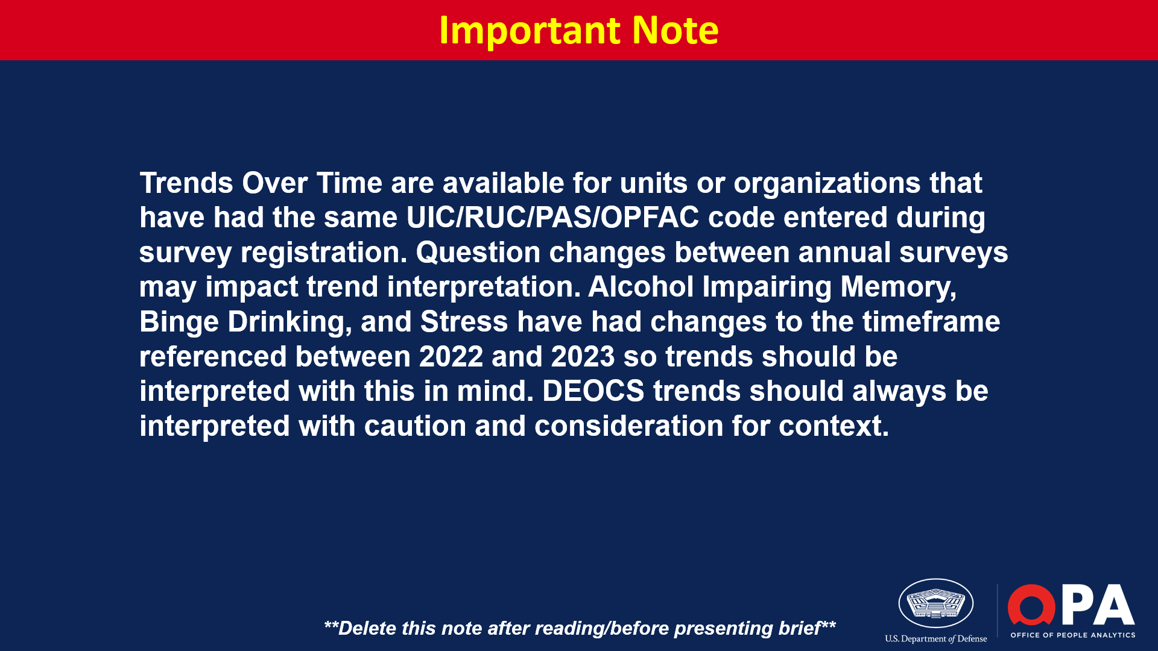
Notes:
**Delete slide if trend data is not available.**
*Trends over time are now available for any units/organizations that have completed more than one DEOCS in the past. All that is required for trends to be presented is the same UIC/RUC/PAS/OPFAC code and that the survey is administered under the same Service component as the previous survey(s).*
Suggested Discussion Points
Identify upward and/or downward trends
Discuss notable differences in response rates when reviewing trends over time.
Identify any other noteworthy trends.

Slide 48
Notes:
Alcohol Impairing Memory measures how often, during the last three months, one was unable to remember what happened the night before due to drinking alcohol.
Unfavorable rating (represented with red) indicates the percentage of participants reporting Frequent Memory Loss Due to Alcohol.
Middle rating (represented with yellow) indicates the percentage of participants reporting Infrequent Memory Loss Due to Alcohol.
Favorable rating (represented with green) indicates the percentage of participants reporting No Memory Loss Due to Alcohol.
Sharing Results with the Commander’s Supervisor
Share results if this factor is an Area of Growth on your unit’s/organization’s Comprehensive Integrated Primary Prevention (CIPP) Plan.
Share results if a Factor Rating Alert icon is present. Factor rating alerts indicate that the unit/organization is at a high risk of experiencing negative outcomes.
Share results if the commander/leader believes there is another reason to share with their supervisor.
Suggested Discussion Points
Discuss activities pertinent to this factor for your unit/organization.
Discuss trends from previous DEOCS results, if applicable.

Slide 49
Notes:
Sharing Results with the Commander’s Supervisor
Share demographic category results if overall results were shared with the previous slide.
Share demographic category results if the commander/leader sees value in sharing these results.
Suggested Discussion Points
Discuss noteworthy differences and outliers in demographic category results.

Slide 50
Notes:
Binge Drinking measures how often, during the last three months, one consumed 5 or more drinks on one occasion. This pattern of drinking alcohol within 2 hours brings blood alcohol concentration (BAC) to 0.08 percent or higher for typical adults.
Unfavorable rating (represented with red) indicates the percentage of participants reporting Frequent Binge Drinking.
Middle rating (represented with yellow) indicates the percentage of participants reporting Infrequent Binge Drinking.
Favorable rating (represented with green) indicates the percentage of participants reporting No Binge Drinking.
Sharing Results with the Commander’s Supervisor
Share results if this factor is an Area of Growth on your unit’s/organization’s Comprehensive Integrated Primary Prevention (CIPP) Plan.
Share results if a Factor Rating Alert icon is present. Factor rating alerts indicate that the unit/organization is at a high risk of experiencing negative outcomes.
Share results if the commander/leader believes there is another reason to share with their supervisor.
Suggested Discussion Points
Discuss activities pertinent to this factor for your unit/organization.
Discuss trends from previous DEOCS results, if applicable.

Slide 51
Notes:
Sharing Results with the Commander’s Supervisor
Share demographic category results if overall results were shared with the previous slide.
Share demographic category results if the commander/leader sees value in sharing these results.
Suggested Discussion Points
Discuss noteworthy differences and outliers in demographic category results.

Slide 52
Notes:
Passive Leadership measures the perception that leaders avoid decisions, do not respond to problems, fail to follow-up, hesitate to act, and are absent when needed. This is also known as laissez-faire leadership.
Unfavorable rating (represented with red) indicates the extent to which the unit’s/organization’s leader is a Passive Leader.
Neutral rating (represented with yellow) indicates the extent to which the unit’s/organization’s leader is Neither a Passive Leader nor Non-Passive Leader.
Favorable rating (represented with green) indicates the extent to which the unit’s/organization’s leader is not a Passive Leader.
Sharing Results with the Commander’s Supervisor
Share results if this factor is an Area of Growth on your unit’s/organization’s Comprehensive Integrated Primary Prevention (CIPP) Plan.
Share results if a Factor Rating Alert icon is present. Factor rating alerts indicate that the unit/organization is at a high risk of experiencing negative outcomes.
Share results if the commander/leader believes there is another reason to share with their supervisor.
Suggested Discussion Points
Discuss activities pertinent to this factor for your unit/organization.
Discuss trends from previous DEOCS results, if applicable.

Slide 53
Notes:
Sharing Results with the Commander’s Supervisor
Share demographic category results if overall results were shared with the previous slide.
Share demographic category results if the commander/leader sees value in sharing these results.
Suggested Discussion Points
Discuss noteworthy differences and outliers in demographic category results.

Slide 54
Notes:
Passive Leadership measures the perception that leaders avoid decisions, do not respond to problems, fail to follow-up, hesitate to act, and are absent when needed. This is also known as laissez-faire leadership.
Unfavorable rating (represented with red) indicates the extent to which the unit’s/organization’s senior NCO/SEL is a Passive Leader.
Neutral rating (represented with yellow) indicates the extent to which the unit’s/organization’s senior NCO/SEL is Neither a Passive Leader nor Non-Passive Leader.
Favorable rating (represented with green) indicates the extent to which the unit’s/organization’s senior NCO/SEL is not a Passive Leader.
Sharing Results with the Commander’s Supervisor
Share results if this factor is an Area of Growth on your unit’s/organization’s Comprehensive Integrated Primary Prevention (CIPP) Plan.
Share results if a Factor Rating Alert icon is present. Factor rating alerts indicate that the unit/organization is at a high risk of experiencing negative outcomes.
Share results if the commander/leader believes there is another reason to share with their supervisor.
Suggested Discussion Points
Discuss activities pertinent to this factor for your unit/organization.
Discuss trends from previous DEOCS results, if applicable.

Slide 55
Notes:
Sharing Results with the Commander’s Supervisor
Share demographic category results if overall results were shared with the previous slide.
Share demographic category results if the commander/leader sees value in sharing these results.
Suggested Discussion Points
Discuss noteworthy differences and outliers in demographic category results.

Slide 56
Notes:
Racially Harassing Behaviors measures the experience or witnessing of offensive behaviors based on race or ethnicity that occurred over the past three months. These behaviors create a workplace that is intimidating, hostile, offensive, or unreasonably intrusive.
Unfavorable rating (represented with red) indicates the percentage of participants reporting a Presence of Racially Harassing Behaviors. In other words, this is the percentage of participants who reported experiencing at least one racially harassing behavior rarely, sometimes, or often in the past three months, which indicates these behaviors are present in the unit/organization.
Favorable rating (represented with green) indicates the percentage of participants reporting No Presence of Racially Harassing Behaviors. In other words, this is the percentage of participants who reported never experiencing any of the racially harassing behaviors in the past three months.
Sharing Results with the Commander’s Supervisor
Share results if this factor is an Area of Growth on your unit’s/organization’s Comprehensive Integrated Primary Prevention (CIPP) Plan.
Share results if a Factor Rating Alert icon is present. Factor rating alerts indicate that the unit/organization is at a high risk of experiencing negative outcomes.
Share results if the commander/leader believes there is another reason to share with their supervisor.
Suggested Discussion Points
Discuss activities pertinent to this factor for your unit/organization.
Discuss trends from previous DEOCS results, if applicable.
Racially Harassing Behaviors are a subset of the 24 behaviors used to create DoD’s official past-year prevalence estimates of racial/ethnic harassment and discrimination as measured by the Workplace Equal Opportunity Surveys.

Slide 57
Notes:
Sharing Results with the Commander’s Supervisor
Share demographic category results if overall results were shared with the previous slide.
Share demographic category results if the commander/leader sees value in sharing these results.
Suggested Discussion Points
Discuss noteworthy differences and outliers in demographic category results.

Slide 58
Notes:
Sexist Behaviors measures prejudicial, stereotypical, or negative attitudes and opinions based on sex that occurred over the past three months. They also include verbal and nonverbal behaviors that convey insulting, offensive, or condescending attitudes based on the sex of an individual.
Unfavorable rating (represented with red) indicates the percentage of participants reporting a Presence of Sexist Behaviors. In other words, this is the percentage of participants who reported experiencing sexist behaviors rarely, sometimes, or often in the past three months, which indicates these behaviors are present in the unit/organization.
Favorable rating (represented with green) indicates the percentage of participants reporting No Presence of Sexist Behaviors. In other words, this is the percentage of participants who reported never experiencing any sexist behaviors in the past three months.
Sharing Results with the Commander’s Supervisor
Share results if this factor is an Area of Growth on your unit’s/organization’s Comprehensive Integrated Primary Prevention (CIPP) Plan.
Share results if a Factor Rating Alert icon is present. Factor rating alerts indicate that the unit/organization is at a high risk of experiencing negative outcomes.
Share results if the commander/leader believes there is another reason to share with their supervisor.
Suggested Discussion Points
Discuss activities pertinent to this factor for your unit/organization.
Discuss trends from previous DEOCS results, if applicable.
Sexist Behaviors are similar to DoD’s policy definition of sex discrimination, but it is important to note the policy definition requires the behaviors to limit or harm the victim’s career and this is not measured on the DEOCS.

Slide 59
Notes:
Sharing Results with the Commander’s Supervisor
Share demographic category results if overall results were shared with the previous slide.
Share demographic category results if the commander/leader sees value in sharing these results.
Suggested Discussion Points
Discuss noteworthy differences and outliers in demographic category results.

Slide 60
Notes:
Sexually Harassing Behaviors are unwelcome sexual advances and offensive comments or gestures of a sexual nature that occurred over the past three months
Unfavorable rating (represented with red) indicates the percentage of participants reporting a Presence of Sexually Harassing Behaviors. In other words, this is the percentage of participants who reported experiencing at least one sexually harassing behavior rarely, sometimes, or often in the past three months, which indicates these behaviors are present in the unit/organization.
Favorable rating (represented with green) indicates the percentage of participants reporting No Presence of Sexually Harassing Behaviors. In other words, this is the percentage of participants who reported never experiencing any of the sexually harassing behaviors in the past three months.
Sharing Results with the Commander’s Supervisor
Share results if this factor is an Area of Growth on your unit’s/organization’s Comprehensive Integrated Primary Prevention (CIPP) Plan.
Share results if a Factor Rating Alert icon is present. Factor rating alerts indicate that the unit/organization is at a high risk of experiencing negative outcomes.
Share results if the commander/leader believes there is another reason to share with their supervisor.
Suggested Discussion Points
Discuss activities pertinent to this factor for your unit/organization.
Discuss trends from previous DEOCS results, if applicable.
Sexually Harassing Behaviors are similar to DoD’s policy definition of sexual harassment, but it is important to note the policy definition requires the behaviors to be sufficiently persistent and severe and this is not measured on the DEOCS.

Slide 61
Notes:
Sharing Results with the Commander’s Supervisor
Share demographic category results if overall results were shared with the previous slide.
Share demographic category results if the commander/leader sees value in sharing these results.
Suggested Discussion Points
Discuss noteworthy differences and outliers in demographic category results.

Slide 62
Notes:
Stress measures the feeling of emotional strain or pressure. Stressed individuals may feel unable to predict or influence valued and prominent aspects of their lives.
Unfavorable rating (represented with red) percentage of responses indicate the extent of Moderate or High Stress within the unit/organization.
Favorable rating (represented with green) percentage of responses indicate the extent of Low Stress within the unit/organization.
Sharing Results with the Commander’s Supervisor
Share results if this factor is an Area of Growth on your unit’s/organization’s Comprehensive Integrated Primary Prevention (CIPP) Plan.
Share results if a Factor Rating Alert icon is present. Factor rating alerts indicate that the unit/organization is at a high risk of experiencing negative outcomes.
Share results if the commander/leader believes there is another reason to share with their supervisor.
Suggested Discussion Points
Discuss activities pertinent to this factor for your unit/organization.
Discuss trends from previous DEOCS results, if applicable.

Slide 63
Notes:
Sharing Results with the Commander’s Supervisor
Share demographic category results if overall results were shared with the previous slide.
Share demographic category results if the commander/leader sees value in sharing these results.
Suggested Discussion Points
Discuss noteworthy differences and outliers in demographic category results.

Slide 64
Notes:
Toxic Leadership measures the perception that leaders disregard input, ridicule others, and have self-promoting tendencies. Toxic Leadership also includes behaviors that are demeaning, isolating, and/or coercive. These types of leaders are also prone to acts of aggression.
Unfavorable rating (represented with red) percentage of responses indicating the immediate supervisor is a Toxic Leader.
Neutral rating (represented with yellow) percentage of responses indicating the immediate supervisor is Neither a Toxic nor Non-Toxic Leaders.
Favorable rating (represented with green) percentage of responses indicating the immediate supervisor is Not a Toxic Leaders.
Sharing Results with the Commander’s Supervisor
Share results if this factor is an Area of Growth on your unit’s/organization’s Comprehensive Integrated Primary Prevention (CIPP) Plan.
Share results if a Factor Rating Alert icon is present. Factor rating alerts indicate that the unit/organization is at a high risk of experiencing negative outcomes.
Share results if the commander/leader believes there is another reason to share with their supervisor.
Suggested Discussion Points
Discuss activities pertinent to this factor for your unit/organization.
Discuss trends from previous DEOCS results, if applicable.

Slide 65
Notes:
Sharing Results with the Commander’s Supervisor
Share demographic category results if overall results were shared with the previous slide.
Share demographic category results if the commander/leader sees value in sharing these results.
Suggested Discussion Points
Discuss noteworthy differences and outliers in demographic category results.

Slide 66
Notes:
Sharing Results with the Commander’s Supervisor
Share by Paygrade of Immediate Supervisor if overall results were shared.
Share by Paygrade of Immediate Supervisor results if the commander/leader sees value in sharing these results.
Suggested Discussion Points
Discuss noteworthy differences and outliers in demographic category results.

Slide 67
Notes:
Toxic Leadership measures the perception that leaders disregard input, ridicule others, and have self-promoting tendencies. Toxic Leadership also includes behaviors that are demeaning, isolating, and/or coercive. These types of leaders are also prone to acts of aggression.
Unfavorable rating (represented with red) indicates the extent to which the Senior NCO/SEL is a Toxic Leader.
Neutral rating (represented with yellow) indicates the extent to which the Senior NCO/SEL is Neither Toxic nor Non-Toxic Leaders.
Favorable rating (represented with green) indicates the extent to which the Senior NCO/SEL is Not a Toxic Leader.
Sharing Results with the Commander’s Supervisor
Share results if this factor is an Area of Growth on your unit’s/organization’s Comprehensive Integrated Primary Prevention (CIPP) Plan.
Share results if a Factor Rating Alert icon is present. Factor rating alerts indicate that the unit/organization is at a high risk of experiencing negative outcomes.
Share results if the commander/leader believes there is another reason to share with their supervisor.
Suggested Discussion Points
Discuss activities pertinent to this factor for your unit/organization.
Discuss trends from previous DEOCS results, if applicable.

Slide 68
Notes:
Sharing Results with the Commander’s Supervisor
Share demographic category results if overall results were shared with the previous slide.
Share demographic category results if the commander/leader sees value in sharing these results.
Suggested Discussion Points
Discuss noteworthy differences and outliers in demographic category results.

Slide 69
Notes:
Workplace Hostility measures the degree to which individuals in the workplace act in a hostile manner towards others. It includes behaviors such insults, sarcasm, or gestures intended to humiliate a member and the perception of others interfering with one’s work performance.
Unfavorable rating (represented with red) percentage of responses indicating Frequent Workplace Hostility.
Neither favorable nor unfavorable rating (represented with yellow) percentage of responses indicating Rare Workplace Hostility.
Favorable rating (represented with green) percentage of responses indicating No Workplace Hostility.
Sharing Results with the Commander’s Supervisor
Share results if this factor is an Area of Growth on your unit’s/organization’s Comprehensive Integrated Primary Prevention (CIPP) Plan.
Share results if a Factor Rating Alert icon is present. Factor rating alerts indicate that the unit/organization is at a high risk of experiencing negative outcomes.
Share results if the commander/leader believes there is another reason to share with their supervisor.
Suggested Discussion Points
Discuss activities pertinent to this factor for your unit/organization.
Discuss trends from previous DEOCS results, if applicable.

Slide 70
Notes:
Sharing Results with the Commander’s Supervisor
Share demographic category results if overall results were shared with the previous slide.
Share demographic category results if the commander/leader sees value in sharing these results.
Suggested Discussion Points
Discuss noteworthy differences and outliers in demographic category results.

Slide 72
Notes:
Suggested Discussion Points
Discuss Written Comment themes.
What did they reveal?
How were themes determined?
Were there any surprises in the comments?
Were there any comments about unauthorized or illegal activity?
What plans are being made to address the themes comments?

Slide 74
Notes:
Suggested Discussion Points
Discuss rationale/reason for choosing these custom closed-ended question results.
Discuss noteworthy results.
If same/similar questions were chosen on previous surveys, discuss changes or trends.

Slide 76
Notes:
Suggested Discussion Points
Discuss noteworthy results.
Discuss changes or trends compared to the previous DEOCS.

Slide 77
Notes:
Suggested Discussion Points
Provide an overview of next steps in the CCA process for the unit/organization.

