Slide 1
Notes:
DEOCS First Look Commander/Leader Template
Slides 1-8 are tutorial slides only. This slide should be deleted from the deck prior to delivering/distributing this brief.
There is no DoW/Service policy or requirement for conducting a DEOCS first look presentation. Conducting this optional brief within 72 hours is a suggested best practice to ensure timeliness of the DEOCS/CCA process.
If you have questions, feedback, or need assistance with this resource, please e-mail the OPA Defense Command Climate Portal User Support Team at DODHRA.OPA-CCA-Support@mail.mil.
**For additional DEOCS support material, please visit the Defense Command Climate Portal Survey Resource Center at https://www.prevention.mil/Climate-Portal/Defense-Climate-Portal-Survey-Resource-Center/**

Slide 2
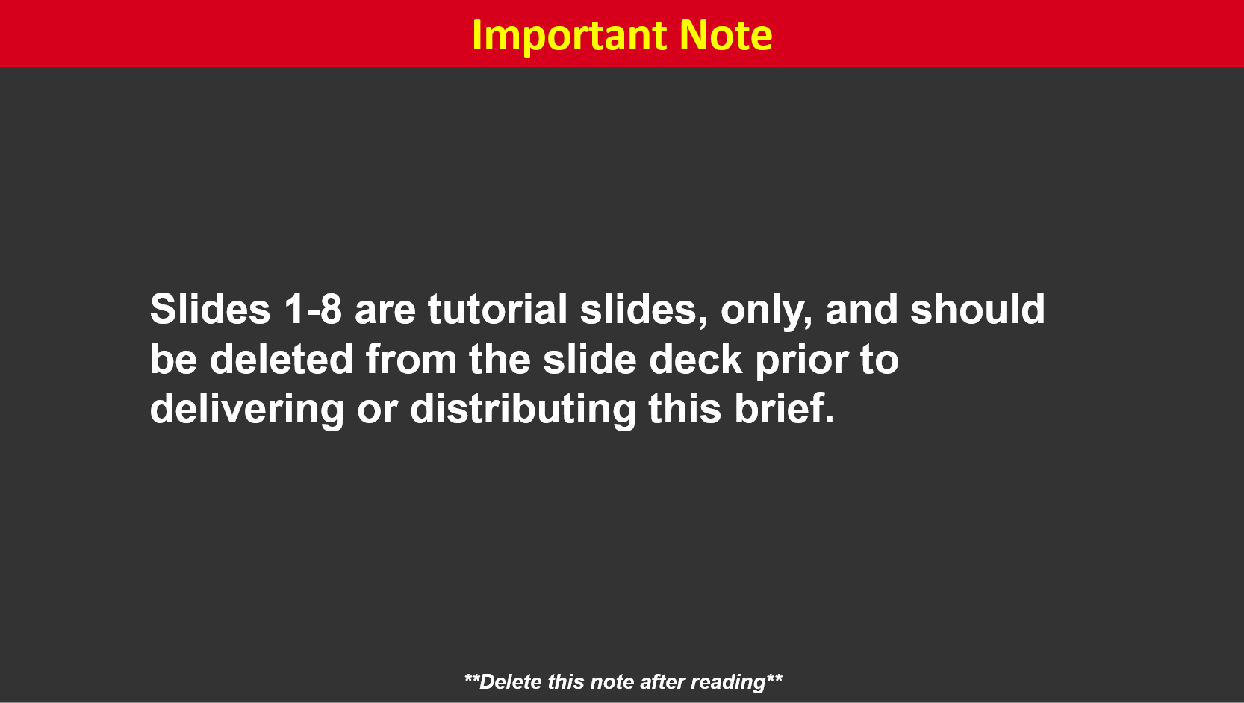
Notes:
Slides 1-8 are tutorial slides only. This slide should be deleted from the deck prior to delivering/distributing this brief.
If you have questions, feedback, or need assistance with this resource, please e-mail the OPA Defense Command Climate Portal User Support Team at DODHRA.OPA-CCA-Support@mail.mil.
**For additional DEOCS support material, please visit the Defense Command Climate Portal Survey Resource Center at https://www.prevention.mil/Climate-Portal/Defense-Climate-Portal-Survey-Resource-Center/**

Slide 3
Notes:
Slides 1-8 are tutorial slides only. This slide should be deleted from the deck prior to delivering/distributing this brief.
If you have questions, feedback, or need assistance with this resource, please e-mail the OPA Defense Command Climate Portal User Support Team at DODHRA.OPA-CCA-Support@mail.mil.
**For additional DEOCS support material, please visit the Defense Command Climate Portal Survey Resource Center at https://www.prevention.mil/Climate-Portal/Defense-Climate-Portal-Survey-Resource-Center/**

Slide 4
Notes:
Slides 1-8 are tutorial slides only. This slide should be deleted from the deck prior to delivering/distributing this brief.
If you have questions, feedback, or need assistance with this resource, please e-mail the OPA Defense Command Climate Portal User Support Team at DODHRA.OPA-CCA-Support@mail.mil.
**For additional DEOCS support material, please visit the Defense Command Climate Portal Survey Resource Center at https://www.prevention.mil/Climate-Portal/Defense-Climate-Portal-Survey-Resource-Center/**

Slide 5
Notes:
Slides 1-8 are tutorial slides only. This slide should be deleted from the deck prior to delivering/distributing this brief.
If you have questions, feedback, or need assistance with this resource, please e-mail the OPA Defense Command Climate Portal User Support Team at DODHRA.OPA-CCA-Support@mail.mil.
**For additional DEOCS support material, please visit the Defense Command Climate Portal Survey Resource Center at https://www.prevention.mil/Climate-Portal/Defense-Climate-Portal-Survey-Resource-Center/**

Slide 6
Notes:
Slides 1-8 are tutorial slides only. This slide should be deleted from the deck prior to delivering/distributing this brief.
If you have questions, feedback, or need assistance with this resource, please e-mail the OPA Defense Command Climate Portal User Support Team at DODHRA.OPA-CCA-Support@mail.mil.
**For additional DEOCS support material, please visit the Defense Command Climate Portal Survey Resource Center at https://www.prevention.mil/Climate-Portal/Defense-Climate-Portal-Survey-Resource-Center/**

Slide 7
Notes:
Slides 1-8 are tutorial slides only. This slide should be deleted from the deck prior to delivering/distributing this brief.
If you have questions, feedback, or need assistance with this resource, please e-mail the OPA Defense Command Climate Portal User Support Team at DODHRA.OPA-CCA-Support@mail.mil.
**For additional DEOCS support material, please visit the Defense Command Climate Portal Survey Resource Center at https://www.prevention.mil/Climate-Portal/Defense-Climate-Portal-Survey-Resource-Center/**

Slide 8
Notes:
Slides 1-8 are tutorial slides only. This slide should be deleted from the deck prior to delivering/distributing this brief.
If you have questions, feedback, or need assistance with this resource, please e-mail the OPA Defense Command Climate Portal User Support Team at DODHRA.OPA-CCA-Support@mail.mil.
**For additional DEOCS support material, please visit the Defense Command Climate Portal Survey Resource Center at https://www.prevention.mil/Climate-Portal/Defense-Climate-Portal-Survey-Resource-Center/**

Slide 10
Notes:
Suggested Discussion Points
Provide an overview of each step of the process.
Consideration
This process incorporates the recently published DoDI 6400.11 guidelines.
Refer to DoD Instruction 6400.11 DoD Integrated Primary Prevention Policy for Prevention Workforce and Leaders and/or Service-specific guidance.

Slide 11
Notes:
Suggested Discussion Points
Discuss noteworthy results.
Discuss previous DEOCS response rates.

Slide 12
Notes:
Suggested Discussion Points
Based on members’ self-reported responses to the DEOCS demographic questions
Demographic results are only reported if there are five or more responses for each sub-section of a given demographic category.

Slide 13
Notes:
Suggested Discussion Points
Highlight the factors with the highest favorable ratings when compared to DoW and Service-level averages and factors that have alerts.

Slide 14
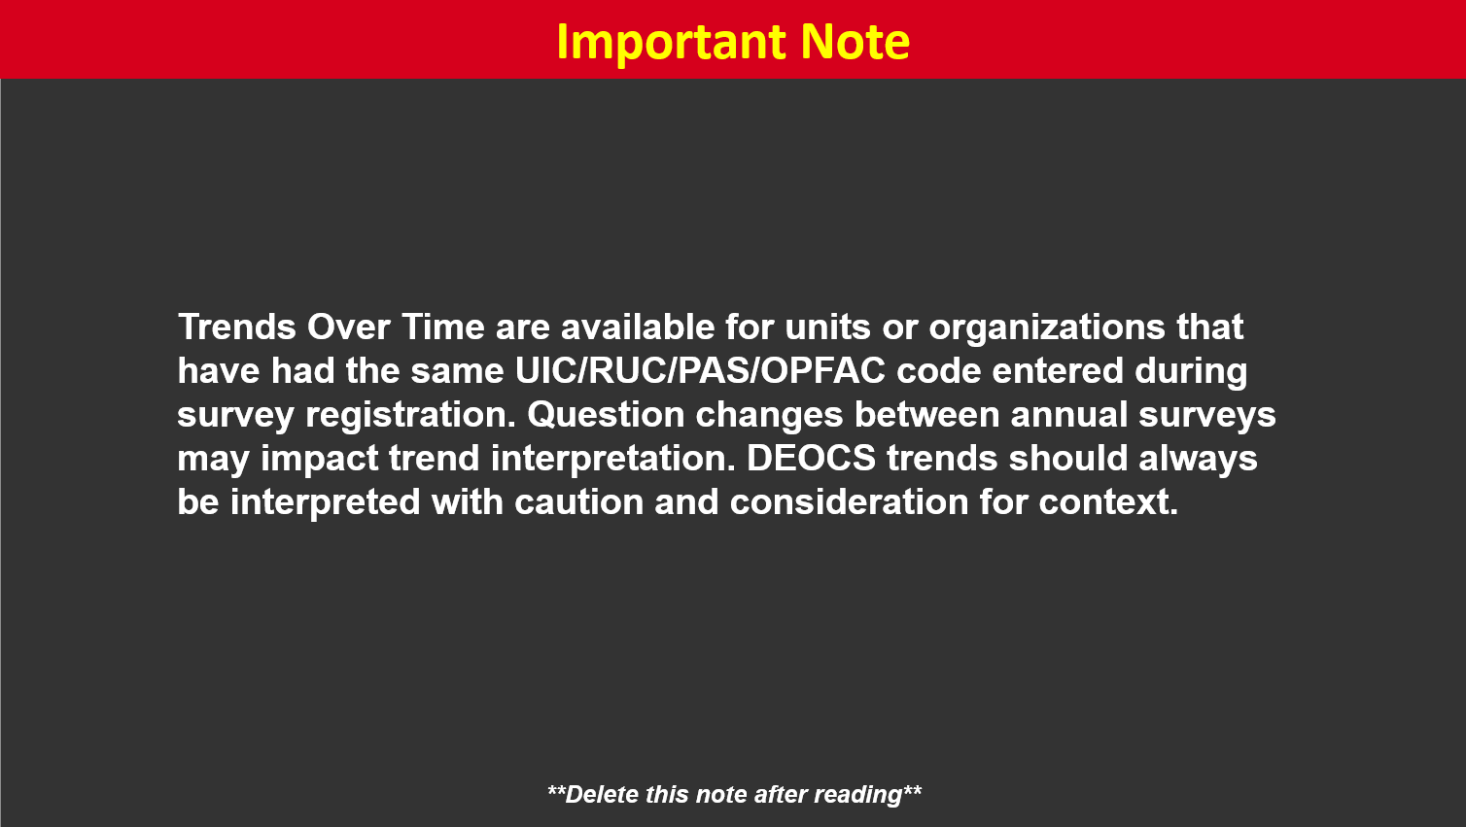
Notes:
**Delete slide if trend data is not available.**
*Trends over time are available for any units/organizations that have completed more than one DEOCS in the past. All that is required for trends to be presented is the same UIC/RUC/PAS/OPFAC code and that the survey is administered under the same Service component as the previous survey(s).*
Suggested Discussion Points
Identify any noteworthy trends.

Slide 15
Notes:
Suggested Discussion Points
Is this historically an area of strength or area of challenge?
Is this one of the best or worst performing factors in this year’s DEOCS? (reference Favorable Ratings chart and DoW/Service-level comparisons)
Need to collect more data for this factor?
Area of focus for the command?

Slide 16
Notes:
Suggested Discussion Points
Is this historically an area of strength or area of challenge?
Is this one of the best or worst performing factors in this year’s DEOCS? (reference Favorable Ratings chart and DoW/Service-level comparisons)
Need to collect more data for this factor?
Area of focus for the command?

Slide 17
Notes:
Suggested Discussion Points
Is this historically an area of strength or area of challenge?
Is this one of the best or worst performing factors in this year’s DEOCS? (reference Favorable Ratings chart and DoW/Service-level comparisons)
Need to collect more data for this factor?
Area of focus for the command?

Slide 18
Notes:
Suggested Discussion Points
Is this historically an area of strength or area of challenge?
Is this one of the best or worst performing factors in this year’s DEOCS? (reference Favorable Ratings chart and DoW/Service-level comparisons)
Need to collect more data for this factor?
Area of focus for the command?

Slide 19
Notes:
Suggested Discussion Points
Is this historically an area of strength or area of challenge?
Is this one of the best or worst performing factors in this year’s DEOCS? (reference Favorable Ratings chart and DoW/Service-level comparisons)
Need to collect more data for this factor?
Area of focus for the command?

Slide 20
Notes:
Suggested Discussion Points
Is this historically an area of strength or area of challenge?
Is this one of the best or worst performing factors in this year’s DEOCS? (reference Favorable Ratings chart and DoW/Service-level comparisons)
Need to collect more data for this factor?
Area of focus for the command?

Slide 21
Notes:
Suggested Discussion Points
Highlight the factors with the lowest unfavorable ratings when compared to DoW and Service-level averages and factors that have alerts.

Slide 22
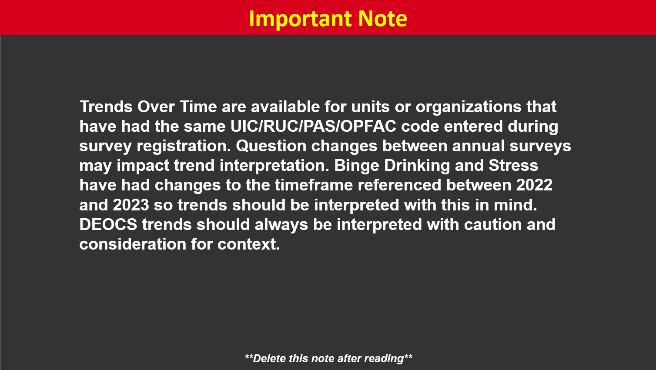
Notes:
**Delete slide if trend data is not available.**
*Trends over time are available for any units/organizations that have completed more than one DEOCS in the past. All that is required for trends to be presented is the same UIC/RUC/PAS/OPFAC code and that the survey is administered under the same Service component as the previous survey(s).*
Suggested Discussion Points
Identify any noteworthy trends.

Slide 23
Notes:
Suggested Discussion Points
Is this historically an area of strength or area of challenge?
Is this one of the best or worst performing factors in this year’s DEOCS? (reference Unfavorable Ratings chart and DoW/Service-level comparisons)
Need to collect more data for this factor?
Area of focus for the command?

Slide 24
Notes:
Suggested Discussion Points
Is this historically an area of strength or area of challenge?
Is this one of the best or worst performing factors in this year’s DEOCS? (reference Unfavorable Ratings chart and DoW/Service-level comparisons)
Need to collect more data for this factor?
Area of focus for the command?

Slide 25
Notes:
Suggested Discussion Points
Is this historically an area of strength or area of challenge?
Is this one of the best or worst performing factors in this year’s DEOCS? (reference Unfavorable Ratings chart and DoW/Service-level comparisons)
Need to collect more data for this factor?
Area of focus for the command?

Slide 26
Notes:
Suggested Discussion Points
Is this historically an area of strength or area of challenge?
Is this one of the best or worst performing factors in this year’s DEOCS? (reference Unfavorable Ratings chart and DoW/Service-level comparisons)
Need to collect more data for this factor?
Area of focus for the command?

Slide 27
Notes:
Suggested Discussion Points
Is this historically an area of strength or area of challenge?
Is this one of the best or worst performing factors in this year’s DEOCS? (reference Unfavorable Ratings chart and DoW/Service-level comparisons)
Need to collect more data for this factor?
Area of focus for the command?

Slide 28
Notes:
Custom Closed-Ended Questions Results:
Discuss noteworthy results.
If same/similar questions were chosen on previous surveys, discuss changes or trends.

Slide 29
Notes:
**Delete slide if Service-specific data is not available.**
Service-Specific Question Results
Discuss noteworthy results.
Discuss changes or trends compared to the results of the previous Service-specific questions.

Slide 30
Notes:
Written Comments | First Glance
Due to the timing of this brief, a thorough analysis of the written comments will likely not be possible. However, this is an opportunity to flag comments considered to be particularly noteworthy.

Slide 31
Notes:
Suggested Discussion Points
Factor Rating Alert Summary
Findings to further evaluate
Next steps in the CCA process

